Slide 1

Chem.312
Instrumental Methods of Analysis
Ch 1

Slide 2
Instruments for analysis
Instrumental Methods of Analysis (CHEM 312) describes the concept and the fundamental of instruments
that based on light and current for qualitative and quantitative analysis.
Converts information stored in the physical or chemical characteristics of the analyte into useful information,
Require a source of energy to stimulate measurable response from analyte.
Data domains
The measurement process is aided by a wide variety of devices that convert information from one form to another. In order to investigate how instruments function , it is important to understand the way in which information is encoded (represented) , or transformed from one system of information to another, as a characteristic of electrical signals .
The various modes of encoding information electrically are called data domains.
Advantages
Defining the problem
Accuracy
Amount of sample
The concentration range of the analyte
Interference
The physical and chemical properties of the sample matrix
Number of samples
Impossibility of analysis using volumetric and Gravimetric analysis.
High sensitivity ( ng, pg….)
Simultaneous analysis
Huge Number of analysis
Identification analysis
Structure analysis

Slide 3
Performance characteristics of instruments
Quantitative characteristics:
Precision
Bias
Sensitivity
Detection limit
Dynamic range
Selectivity
Qualitative characteristics :
Speed
Ease and convenience
Skill required
Coast and availability
Per-sample cost
Introduction to spectrometric methods
Spectrophotometry
is the measurement of these interactions i.e. the measurement of the intensity of light absorbed , emitted or scattered at a selected wavelength.
Spectrometry or spectrometric methods refer to the measurement of the intensity of radiation with photoelectric transducer or other type of electronic device.
Spectroscopy is the study of the interaction between the electromagnetic radiation and the matter.
The method depends on the light absorbing property of either the analyte or one of it`s derivatives .

Slide 4
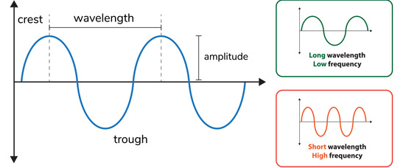
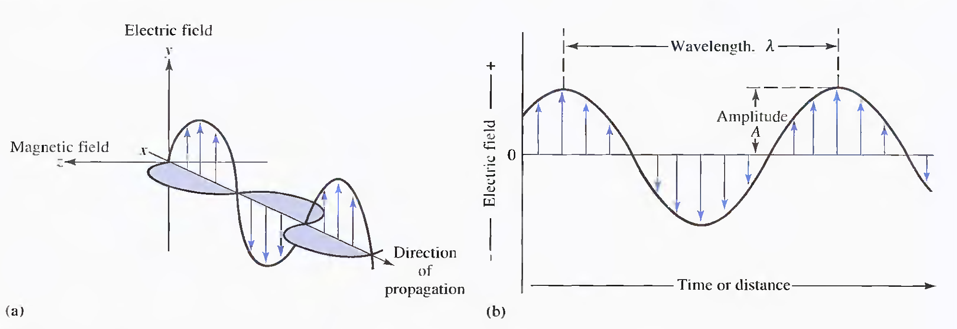
Wave Properties of Electromagnetic Radiation (EMR)
It is a form of energy that has both Wave and Particle Properties that can be characterized by :
λ is the wavelength of the waves
ν is the frequency of the waves
c is the speed of light
Figure. Wave nature of a beam of single-frequency electromagnetic radiation.
In (a). a plane-polarized wave is shown propagating along the x-axis. The electric field oscillates in a plane perpendicular to the magnetic field,
If the radiation were unpolarized a component of the electric field would be seen in all planes.
In (b).. only the electric field oscillations are shown.

Slide 5
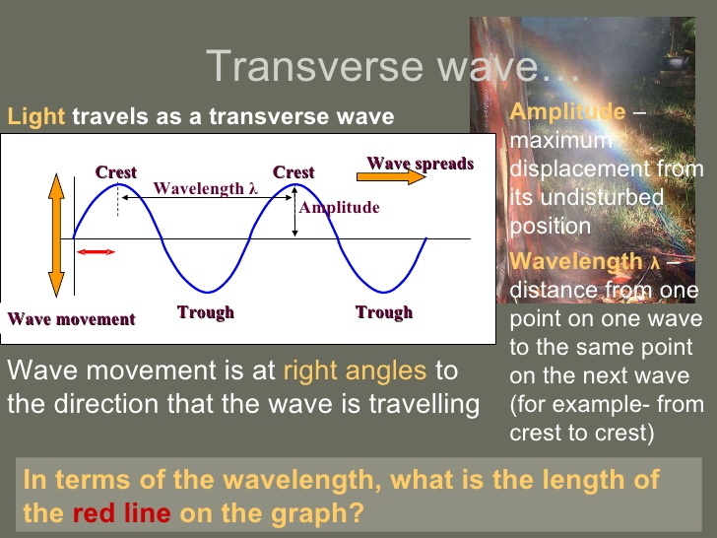
Wave characteristics
1- Amplitude (A)
It is the maximum vertical displacement of the wave from normal position.
2- Wave length (λ ) (nm, μm, cm, m)
It is a measure of distance between two identical adjacent peaks (high points or crests) or troughs (low points) in a wave.
3- Frequency (v)
It is the number of waves or cycles that pass a fixed point per second. The unit of frequency is Hertz (Hz), (s⁻¹)
4- Wave number ( v )
It is the number of waves in a unit length or distance per cm in units of cm⁻¹
5- Period (P)
It is the time required for one cycle to pass a fixed point in space.
Radiant Power ( P ): The amount of energy reaching a given area per second. Unit in watts (W)
Intensity ( I ): The radiant power per unit solid angle.
Absorbance spectrum: A graph of a sample’s absorbance of electromagnetic radiation versus wavelength.

Slide 6
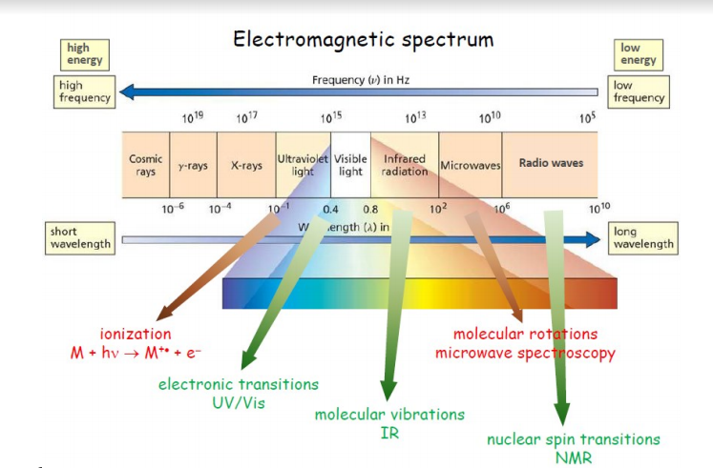
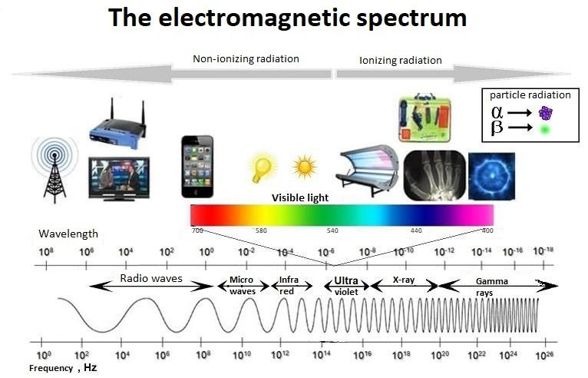
The Electromagnetic Spectrum
The EMR spectrum is the entire range of EMR waves in order of increasing frequency and decreasing wavelength.

Slide 7
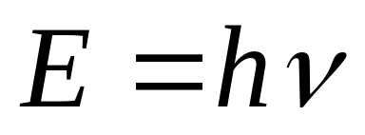
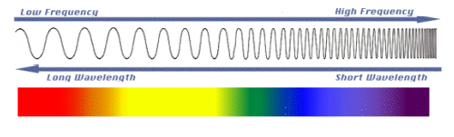
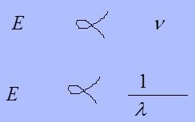
Quantum Mechanical Properties of Radiation
The energy of one particle of light (photon) is proportional to its frequency and can be given by :
where: E = photon energy (Joules) or (electron volts (eV))
v = frequency (sec-1)
h = Planck’s constant (6.626x10-34J.s)
In vacuum, velocity of light : c = νλ = 3 x 10¹⁰ cm/s
which gives, ν =c/λ , E = h (c/λ)

Slide 8
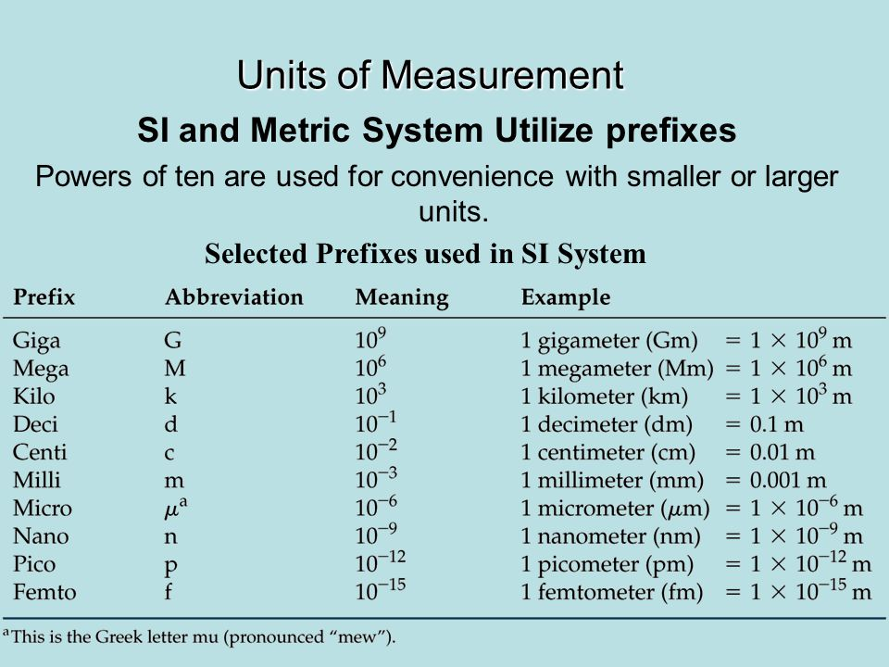
Region | Wavelength Range
UV | 180 – 380 nm
Visible | 380 – 780 nm
Near-IR | 0.78 – 2.5 μm
Mid-IR | 2.5 – 50 μm
Notes :
Angstrom unit (A◦) : a unit of length equal to 1 x 10⁻¹⁰ meter.
Nanometer unit ( nm) : a unit of length equal to 1x10⁻⁹ meter.
Regions of the UV, visible and IR spectrum
Prefixes for units

Slide 9
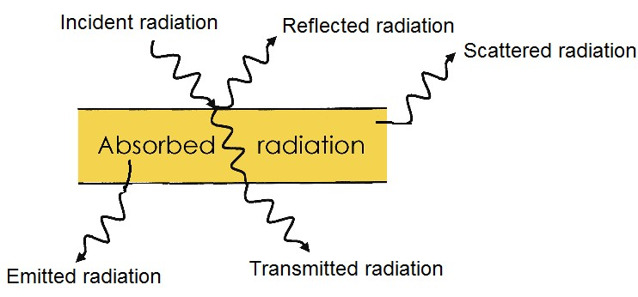
Classification of spectroscopic methods
1- Nature of the interaction of radiation and matter.
The various techniques can be classified in several ways
2- Type of EM radiation.
3- Type of material (matter ).
1- Interaction of Radiation and matter
Types of spectroscopy can be distinguished by the nature of the interaction between the EM radiation and the material
A-Absorption: a transition from a lower level to a higher level with transfer of energy from the radiation field to the atom or molecule.
B- Emission: a transition from a higher level to a lower level, if energy is transferred to the radiation field, or nonradiative decay if no radiation is emitted.
C- Scattering: redirection of light due to its interaction with matter,
and may or may not occur with transfer of energy.

Slide 10
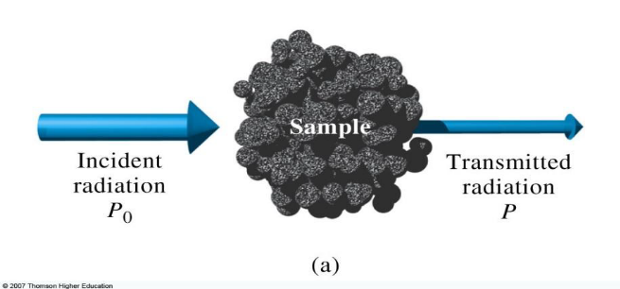
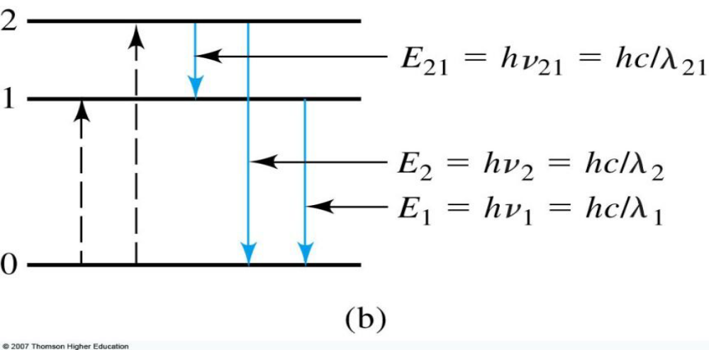
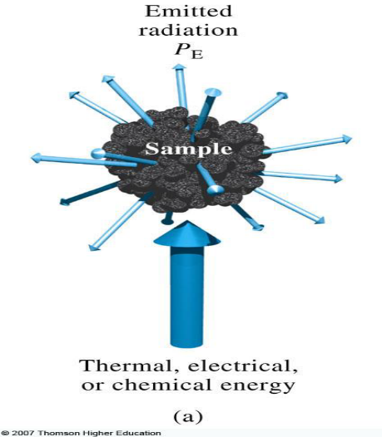
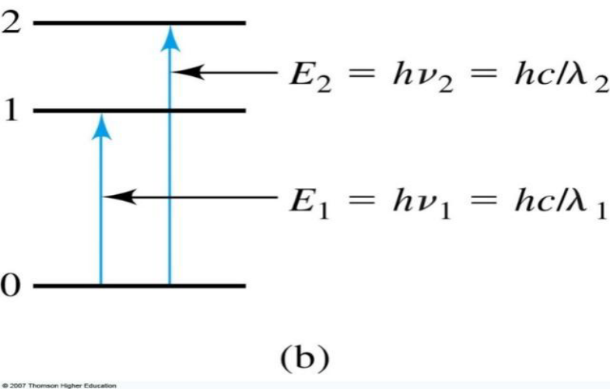
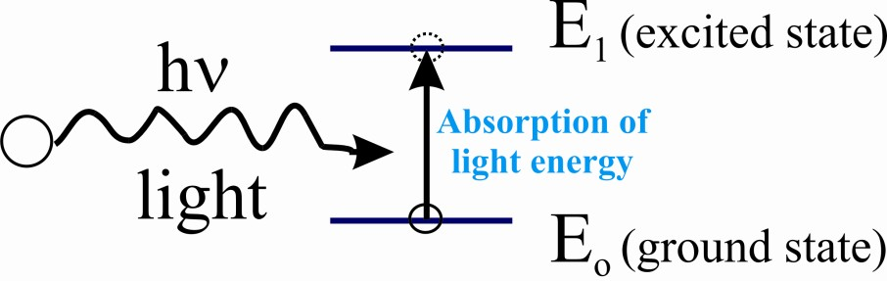
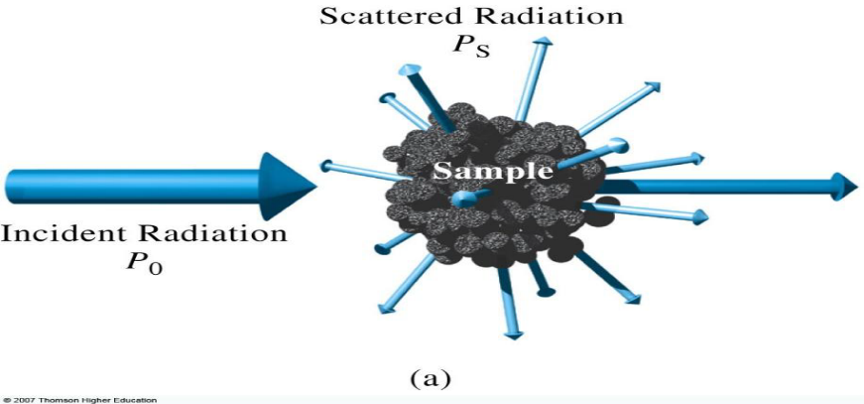
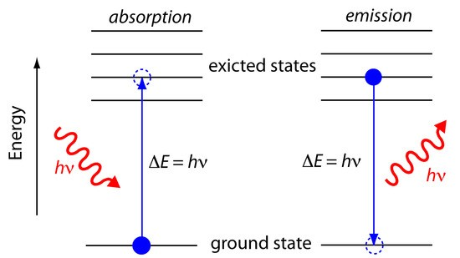
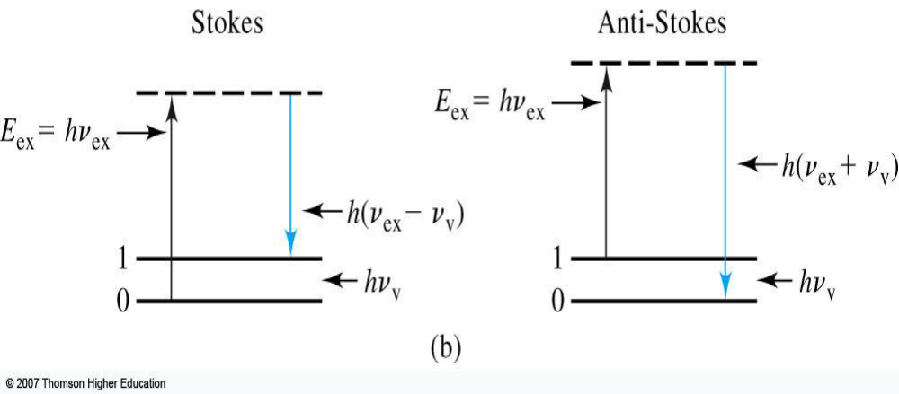
1. Absorption
2. Emission and Chemiluminescence
Ground and Excited State
Under the normal condition electrons exist in the ground state but when a chemical absorbs light, these electrons goes from a low energy state (ground state) to a higher energy state (excited state)
Energy required of photon to give this transition: ΔΕ = Ε₁ − Ε_{ο}
- Only photons with energies exactly equal to the energy difference between the two electron states will be absorbed.
3. Scattering
ــ When a photon of energy hν strikes the atom or molecule, absorption may occur if the difference in energy, ∆E, between the ground state and the excited state is equal to the photon’s energy
ـــ An atom or molecule in an excited state may emit a photon and return to the ground state. The photon’s energy, hν, equals the difference in energy, ∆E, between the two states.

Slide 11
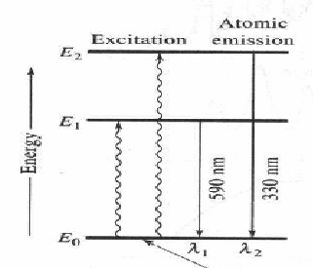
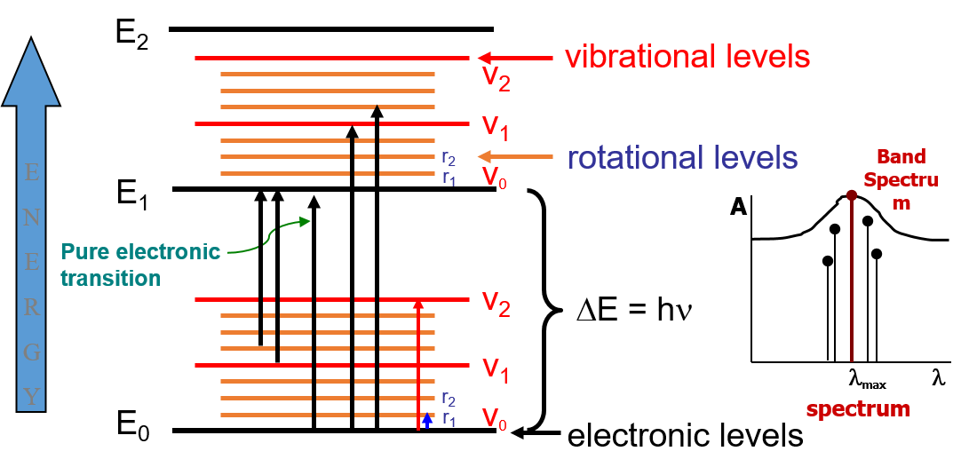
Gamma-ray Spectroscopy
X-ray Spectroscopy
UV-visible Spectroscopy
Infrared Spectroscopy
Laser Spectroscopy
2- Types of radiative energy
(EM radiation)
3- Types of matter
a) Atoms
b) Molecules
c) Nuclei
-Atomic transitions involve changes in the electron orbitals. These changes could be in X-Rays region and cause chances involving the innermost electron shells of the atom. Changes in outer electron shells could be in the visible light region of the spectrum.
-The atomic spectrum consists of few lines, therefore it is sometimes termed line spectrum .
- Rotations are collective motions of the atomic nuclei and typically lead to spectra in the microwave spectral regions; rotational spectroscopy and microwave spectroscopy are synonymous.
- Vibrations are relative motions of the atomic nuclei and are studied by both infrared and Raman spectroscopy.
- electronic excitations are studied using visible and ultraviolet absorption and emission spectroscopy.
- Nuclei also have distinct energy states that are widely separated and lead to gamma ray spectra.
- Distinct nuclear spin states can have their energy separated by a magnetic field, and this allows for NMR spectroscopy
The energy of a band in a molecular absorption spectrum is the sum of three different energy components.
E = E electronic + E vibrational + E rotational
Transitions between electronic-vibrational-rotational states give rise to spectra that appear to have bands.
E₀ – lowest energy electronic level or ground state
E₁, E₂ – higher-energy electronic levels

Slide 12
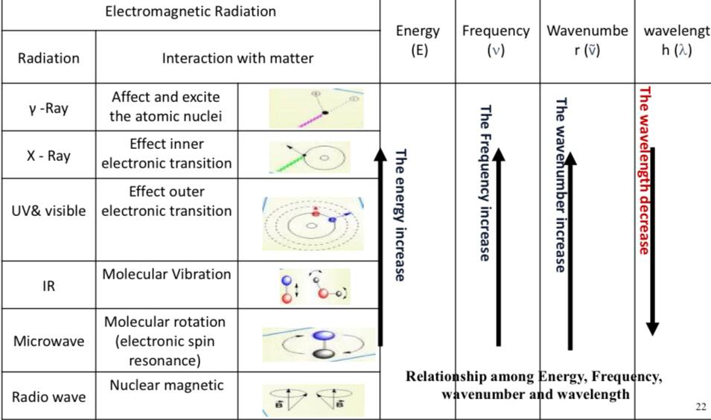
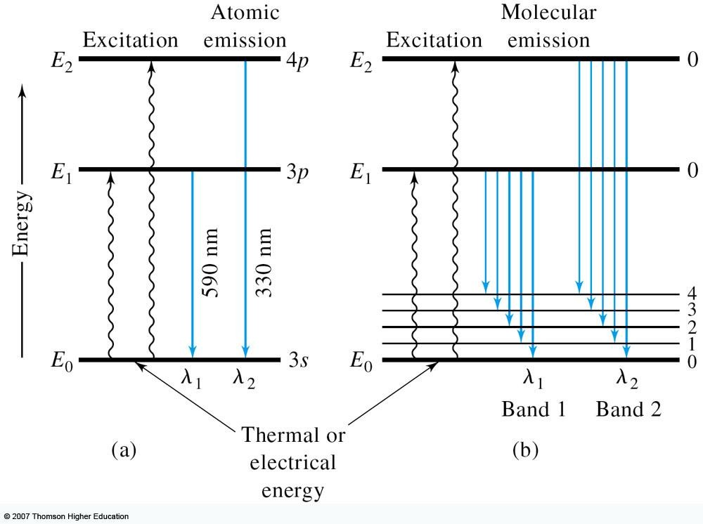


Interaction of EMR with matters
Infrared primarily acts set molecules into vibration.
UV and visible light primarily acts to elevate electron to higher energy levels.

Slide 13
Absorption Induced by a Magnatic Field
Additional quantized energy levels can be observed as a result of strong magnetic field. Absorption will appear at longer wavelength.
Nuclear transitions are between energy levels in the nucleus. Types of nuclear transitions lead to the emission of alpha, beta, or gamma radiation.
Absorption by nuclei or by electrons in magnetic fields is studied by nuclear magnetic resonance (NMR) and electron spin resonance (ERS) techniques, respectively.
Relaxation Processes
Emission of Radiation
Lifetime of excited atom or molecule is short because there are several relaxation processes that permit its return to the ground state.
1. Nonradiative Relaxation
Involves lose of energy in small steps as kinetic energy by collision
2. Fluorescence and Phosphorescence
Analytically important
Fluorescence more rapidly than phosphorescence
When excited particles relax to lower energy levels, they give up their excess energy as photons (emission).
Excitation can be done by:
Bombardment with electrons (X-ray emission)
Electric excitation (e.g. arc , spark, furnace or plasma) or intense heat source (e.g. flame) (UV, visible, or IR emission).
Beam of electromagnetic radiation (fluorescence).
Chemical reaction (Chemiluminescence) .

Slide 14
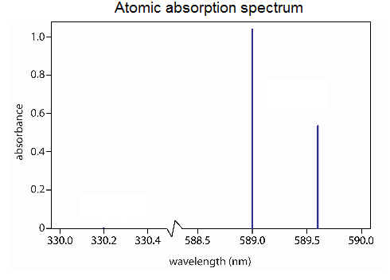
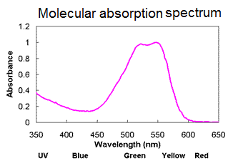
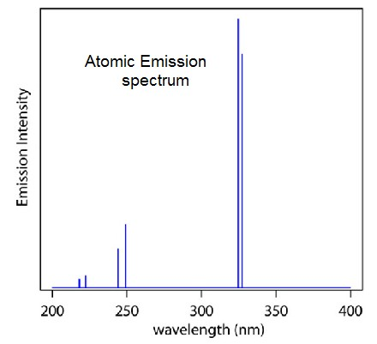
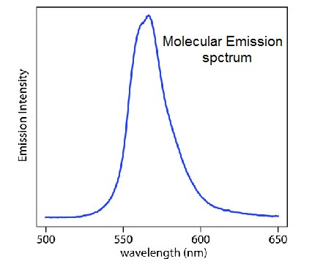
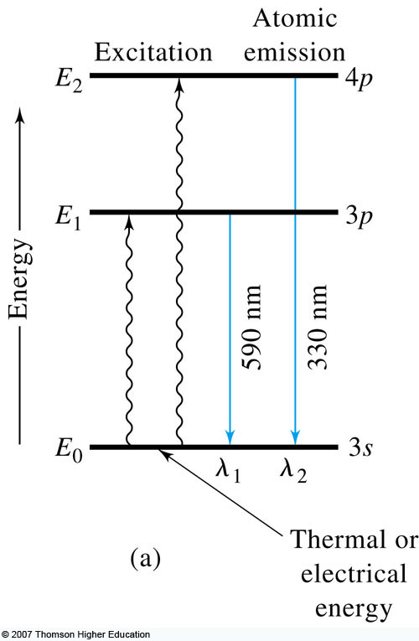
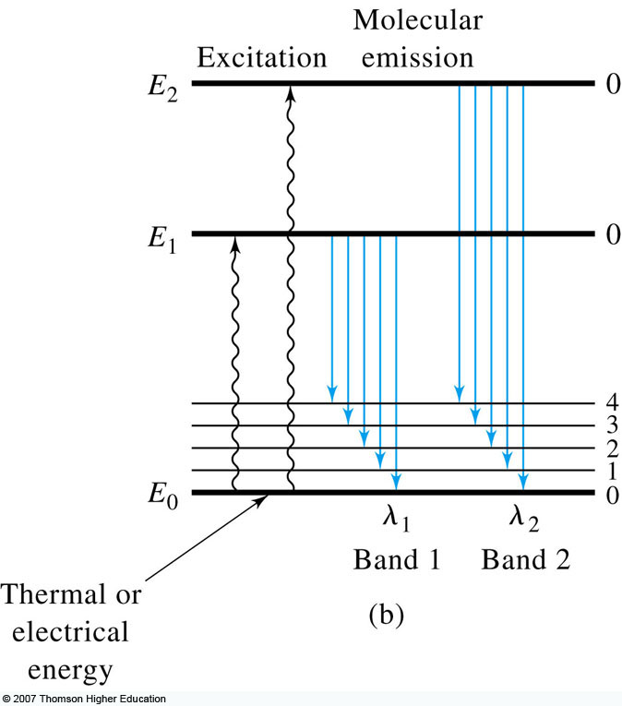
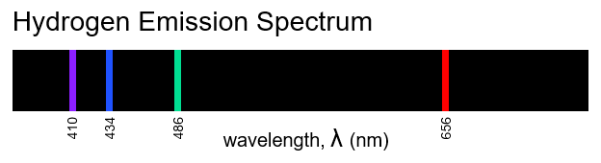
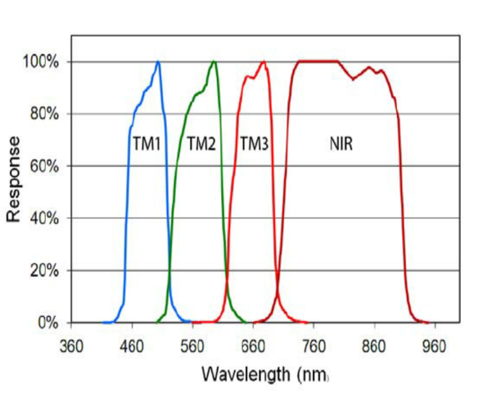
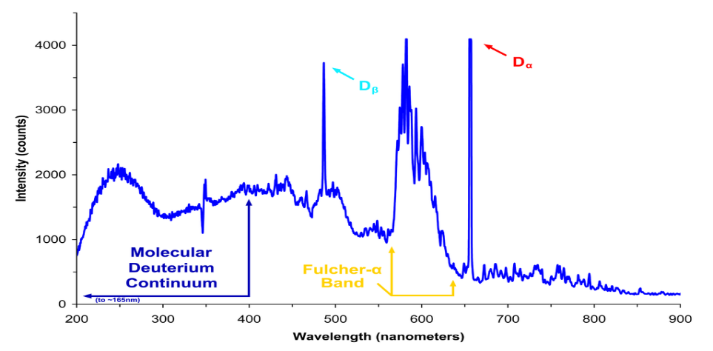
Types of Spectra
1- Absorption spectrum
2- Emission of Radiation
  A plot of the absorbance of the amount of light absorbed by a sample (atom or molecule) as a function of wavelength or frequency.
  A plot of the relative power (intensity or abundance) of the emitted radiation as a function of wavelength or frequency.
Shape of spectra
1- Line spectra
2- Band spectra
3- Continuum Spectra
c
It is produced by molecules. They are the groups of lines which are closely spaced
to one another.
Small molecules and radicals
c
Produced when solid are heated to emit light
A spectrum that contains or appears to contain all wavelengths but not spectrum lines over a wide portion of its range.
Black-body radiation is the type of EMR within or surrounding a body in thermodynamic equilibrium with its environment
It is a spectrum that consists of narrow, brightly colored, parallel lines on a dark background
Individual atoms, well separated, in a gas phase

Slide 15

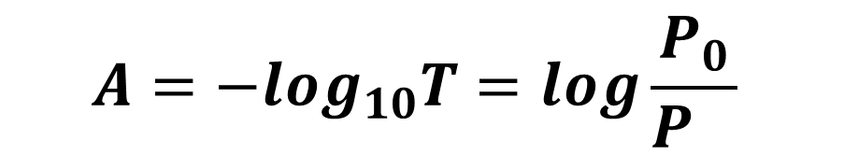
Quantitative Aspects of Spectrochemical Measurements
Key terms and relations:
Beer’s Law:
- Absorbance is directly proportional to the
path length, b,
the concentration, c,
and a proportionality constant called the absorptivity, a, or in other words;
A= abc
When concentration is in Molarity and cell length is in cm, then a is equal to the molar absorptivity, ε, with units L.mol⁻¹.cm⁻¹
A= εbc
Transmittance:
$T=\frac{P}{P_{0}}$ $\%T=\frac{P}{P_{0}} ×100$
$$A=−\log_{10}T=log\frac{P_{0}}{P_{}}$$
Absorbance:
P₀= incident radiation; P= transmission radiation

