Slide 1

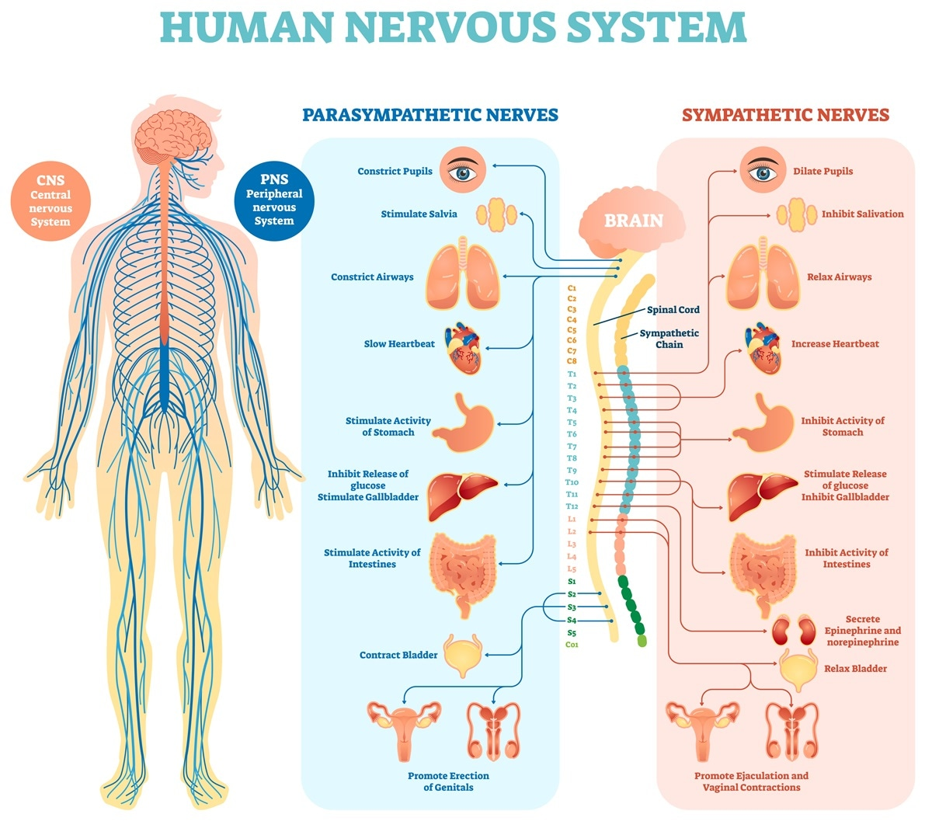
Chapter 28
Nervous Systems
* The slides are copied from the original slides of the course with some additions from Ms. Halima Rais
* تم استخدام العرض التقديمي الخاص بالمادة الأصلية مع إضافات من الشارحة حليمة ريس
Ref:https://shortest.link/7faK

Slide 2
Nervous System Structure And Function

Slide 3
28.1 Nervous systems receive sensory input, interpret it, and send out commands
• Two major organ systems are responsible for coordinating functions of the animal body:
the endocrine system, with slower and more sustained responses.
2. the nervous system, with faster and less sustained responses

Slide 4
• Communication within the nervous system relies on neurons, nerve cells that transmit information via electrical and chemical signals.
• A neuron consists of
• a cell body, containing the nucleus and other cell organelles, and
• long, thin extensions (Axon) that convey signals.

Slide 5
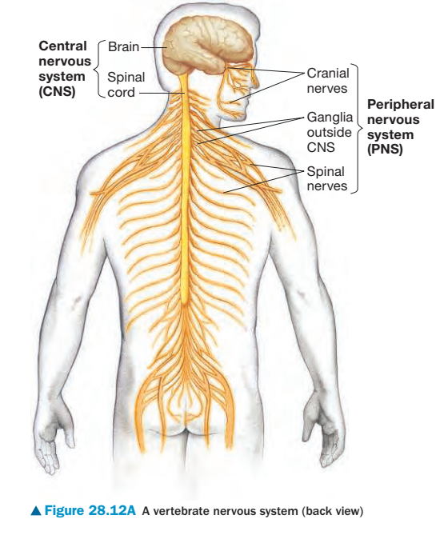
• Nervous systems usually have two main anatomical divisions.
1. The central nervous system (CNS) consists of the
• Brain and
• Spinal cord (vertebrates).
2. The peripheral nervous system (PNS) is located outside the CNS and consists of
• nerves (bundles of neurons wrapped in connective tissue ) and
• ganglia (clusters of neuron cell bodies).

Slide 6
• A nervous system has three interconnected functions:
1.Sensory input is the conduction of signals from sensory receptors.
2.Integration is the analysis and interpretation of the sensory signals in the brain and spinal cord and the formulation of appropriate responses.
3. Motor output is the conduction of signals from the integration centers through the PNS to effector cells, such as muscle cells or gland cells, which perform the body’s responses.

Slide 7
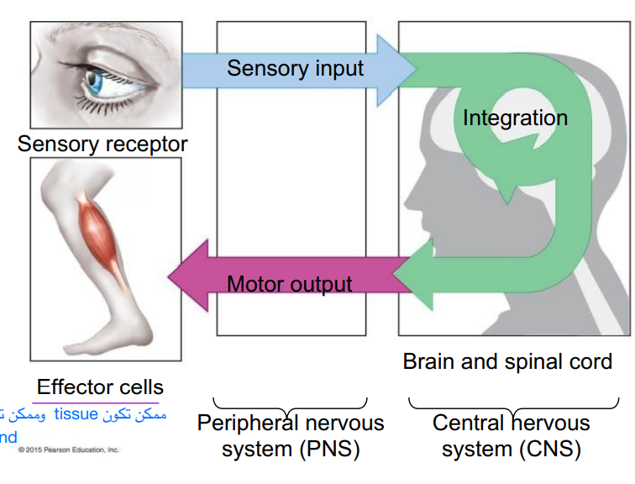

Slide 8
• Three functional types of neurons correspond to a nervous system’s three main functions:
1.Sensory neurons convey signals from sensory receptors into the CNS.
2. Interneurons are located entirely within the CNS, integrate data, and then relay appropriate signals to other interneurons or to motor neurons.
3. Motor neurons convey signals from the CNS to effector cells.

Slide 9
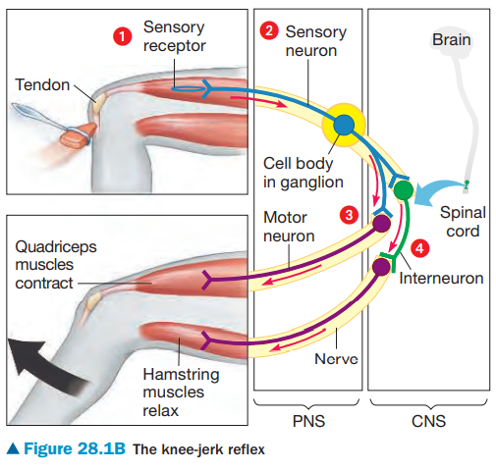
The relationship between neurons and nervous system structure and function can be seen in reflexes, or automatic responses to stimuli.

Slide 10
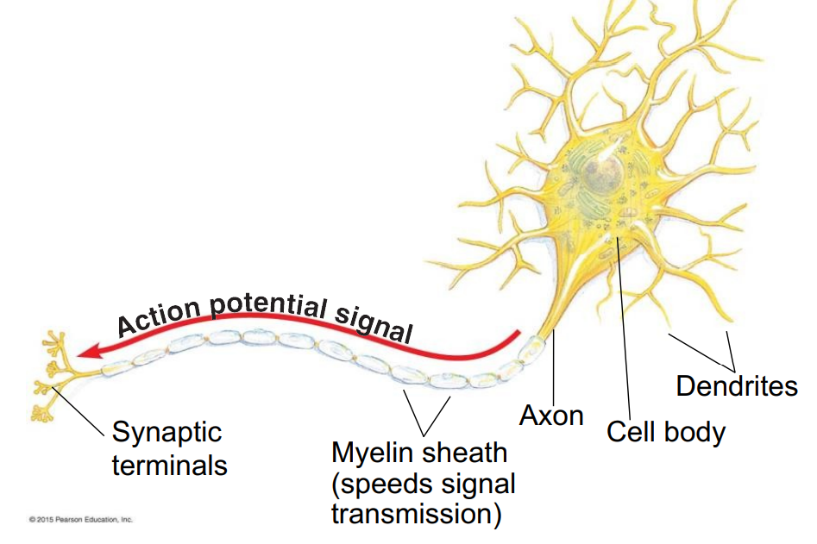
28.2 Neurons are the functional units of nervous systems
• Neurons have two unique extensions arising from the neuron cell body. 1. Dendrites are highly branched, often short, extensions that receive signals from other neurons and convey this information toward the cell body.
2. Axons are typically a much longer extension that transmits signals to other cells, which may be other neurons or effector cells.

Slide 11
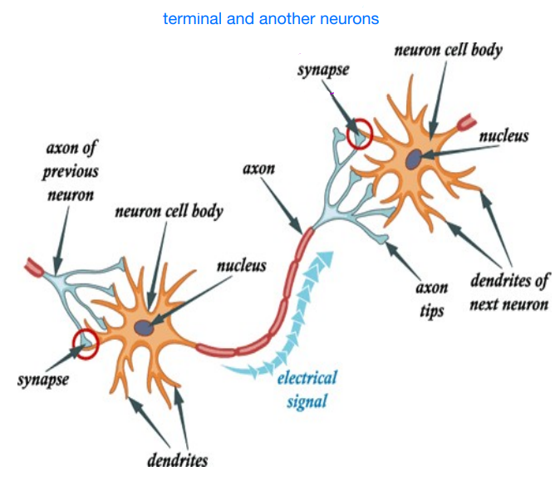
• A typical axon has hundreds or thousands of branches, each with a synaptic terminal at the very end.
• The junction between a synaptic terminal and another cell is called a synapse, or relay point.
• At a synapse, electrical or chemical signals are transmitted to other neurons or effector cells.

Slide 12
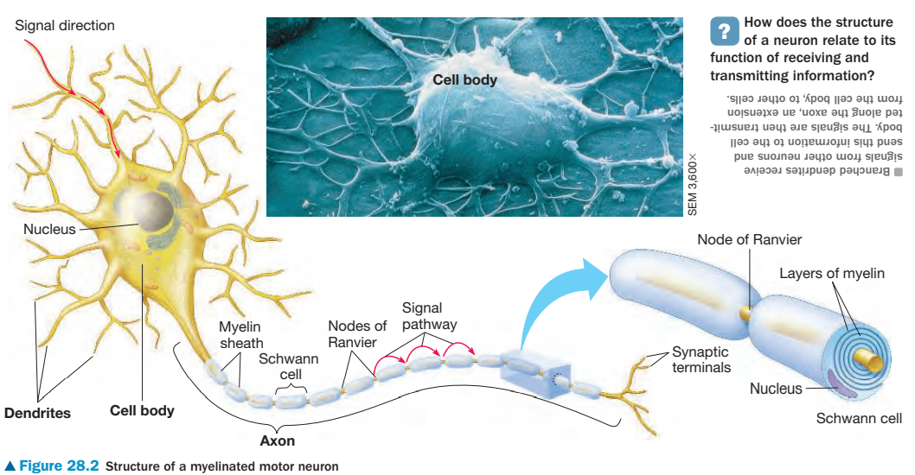

Slide 13
• To function normally, neurons of all vertebrates and most invertebrates have supporting cells called glia.
• A Schwann cell, a type of glia found in the PNS, often wraps an axon along most of its length in a thick insulating material called the myelin sheath, analogous to the plastic insulation that covers many electrical wires.
• The gaps between Schwann cells are called nodes of Ranvier, an adaptation that increases the speed of signals along an axon.

Slide 14
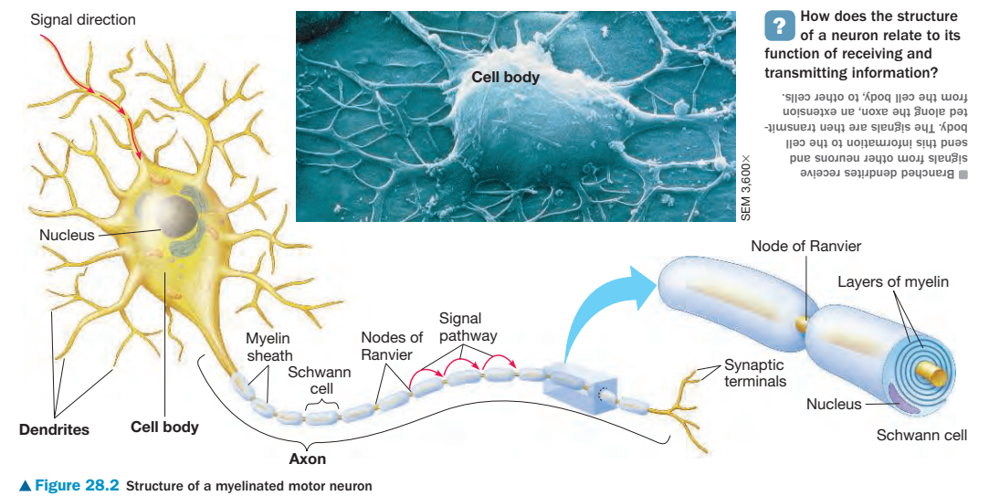

Slide 15
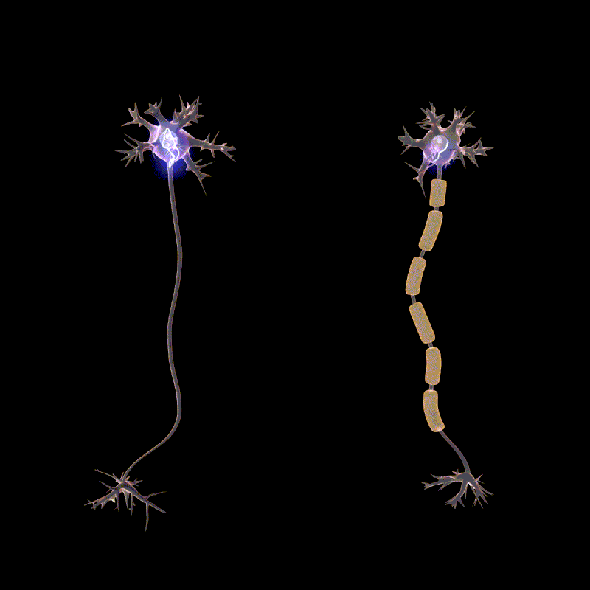
Ref:https://shortest.link/7z8n
يكون انتشار جهود الفعل على طول محاورالخلايا العصبية الميالينية (على اليمين) أسرع بكثير مما هو عليه في المحاور الغير ميالينية (على اليسار)، وذلك بسبب التوصيل القفزي.

Slide 16
Nerve Signals and Their Transmission

Slide 17
28.3 Nerve function depends on charge differences across neuron membranes
• At rest, when a neuron is not transmitting a signal, a neuron’s plasma membrane has potential energy —the membrane potential exists as an
electrical charge difference across the neurons plasma membrane
• inside the cell is slightly negative and outside the cell is slightly positive.
• The resting potential is the voltage across the plasma membrane of a resting neuron.
A neuron’s resting potential is about -70 millivolts (mV)

Slide 18
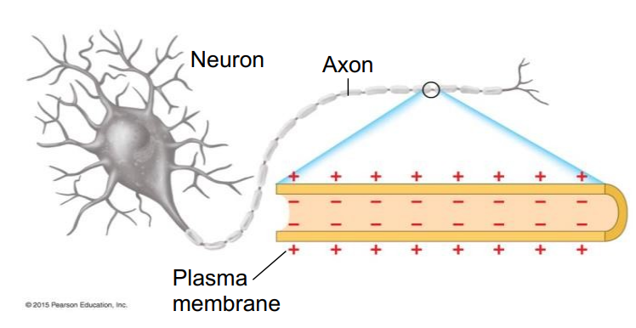

Slide 19
• The resting potential exists because of differences in ion concentration of the fluids inside and outside the neuron.
• Inside the neuron, K+ is high and Na+ is low.
• Outside the neuron, K+ is low and Na+ is high.
• Sodium-potassium (Na+-K+) pumps use energy from ATP to actively move Na+ out of the neuron and K+ into the neuron.

Slide 20
• Ion channels: a resting membrane has many open K+ channels but only few open Na+ channels
• Thus, potassium ions diffuse outward along their concentration gradient more than sodium ions move into the neuron.

Slide 21
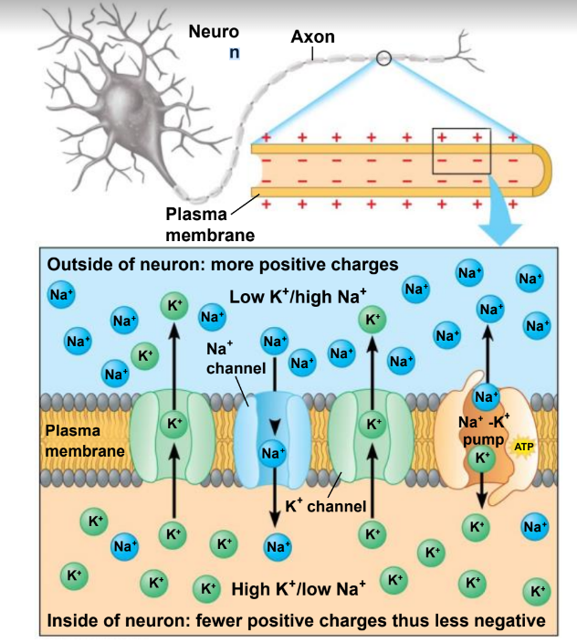
more

Slide 22
28.4 A nerve signal begins as a change in the membrane potential
A nerve signal, called an action potential,
  • is a change in the membrane voltage,
  • that transmits a nerve signal along an axon.
The rapid flip-flop of the membrane potential is
  • a result of the rapid movements of ions across the membrane
  • at Na+ and K+ voltage-gated channels,
  • that open and close in response to stimuli.

Slide 23
• A stimulus is any factor that causes a nerve signal to be generated.
• The nerve signal transmission process, summarized in Figure 28.4, applies to neurons in nearly all animals, including humans.

Slide 24
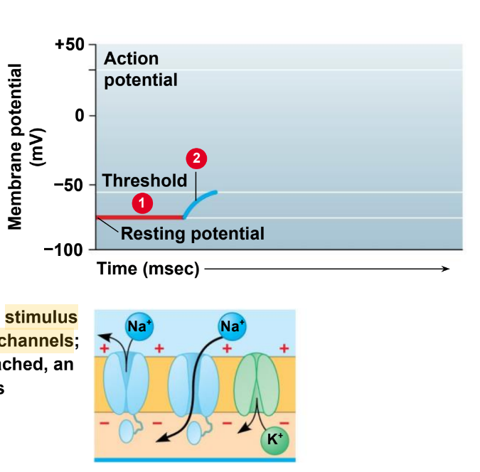
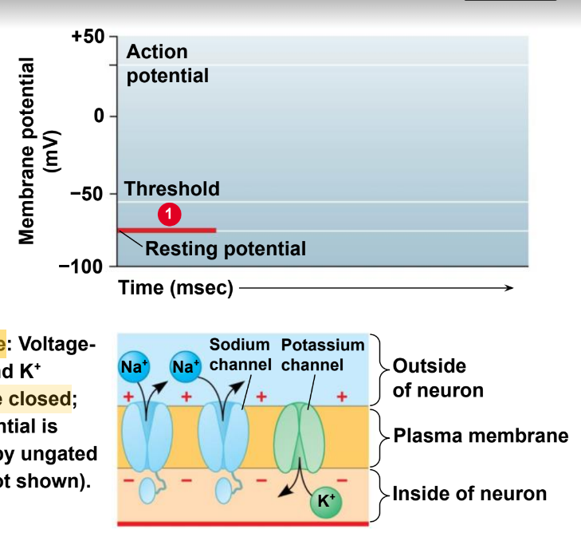



Slide 25
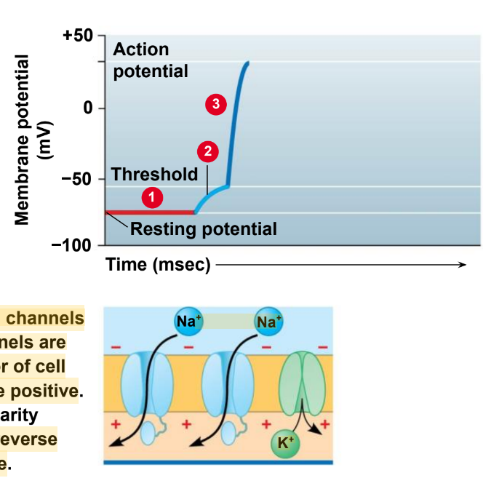
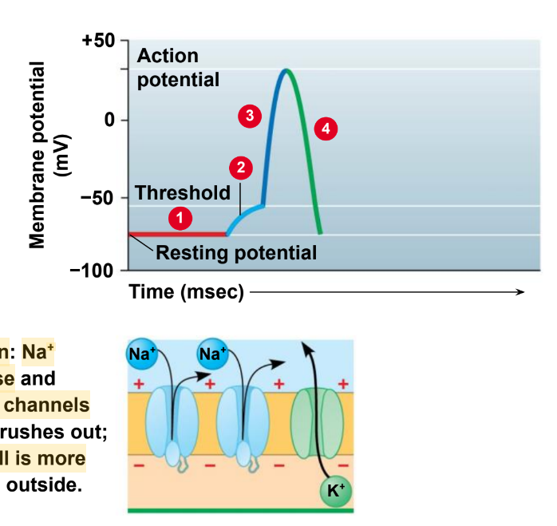
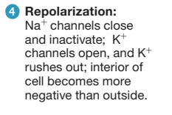
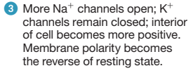

Slide 26
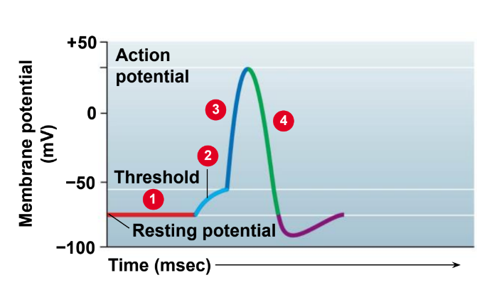
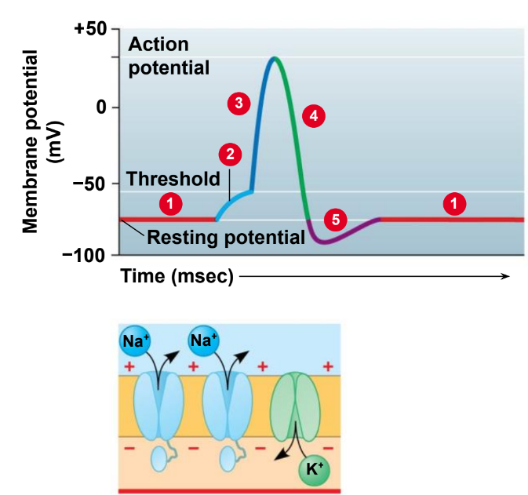



Slide 27
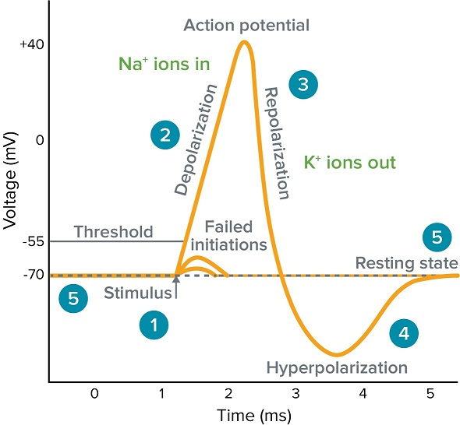
Ref:https://shortest.link/90-I

Slide 28
28.5 The action potential propagates itself along the axon
• Action potentials are
• self-propagated in a one-way chain reaction along a neuron and all-or-none events.
• A nerve signal starts out as an action potential generated in the axon.
• The three steps show the changes that occur in an axon segment as a nerve signal passes from left to right.

Slide 29
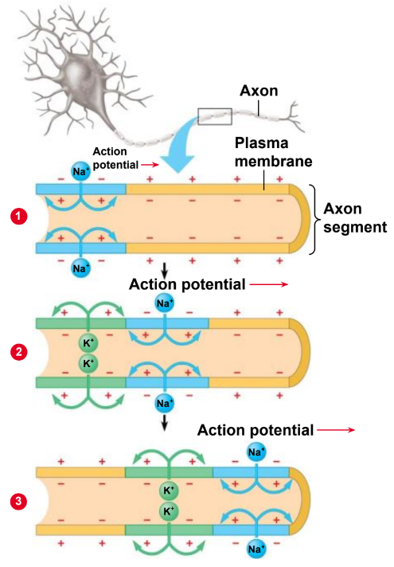
Figure 28.5 Propagation of the action potential along an axon

Slide 30
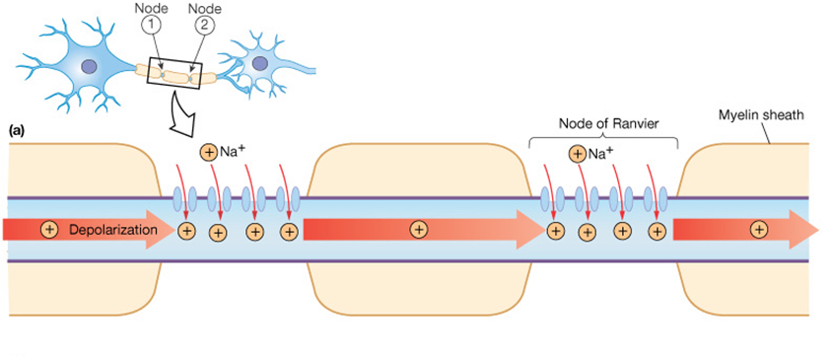
• Impulse is transmitted more rapidly if an axon is myelinaited.
The voltage-gated Na channels are restricted to the node of Ranvier, thus the process of opining and closing these channel occurs at only a limited number of position along a myelinated axon.
• Action potential are propagated along the axon in only one direction from cell body toward the synaptic terminals.
Ref:http://pittmedneuro.com/actionpotentials.html

Slide 31
• Action potential are all- or- non events, that is they are the same no matter how strong or weak the stimulus that triggers them, as long as threshold is reached.

Slide 32
28.6 Neurons communicate at synapses
• Synapses are relay points between a synaptic terminal of a sending neuron and a receiving cell.
• The receiving cell can be
• another neuron or an effector cell such as a muscle cell or endocrine cell.

Slide 33
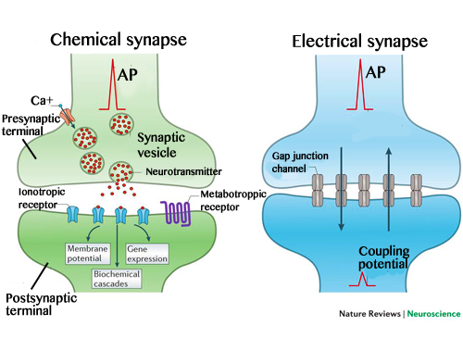
• Synapses come in two varieties:
In an electrical synapse, electrical current flows directly from a neuron through gap junctions.
2. At chemical synapses, the sending (presynaptic) cell secretes a chemical signal, a neurotransmitter, which crosses the synaptic cleft, and the neurotransmitter binds to a specific receptor on the surface of the receiving ( postsynaptic) cell.
Ref:https://shortest.link/99Xl

Slide 34
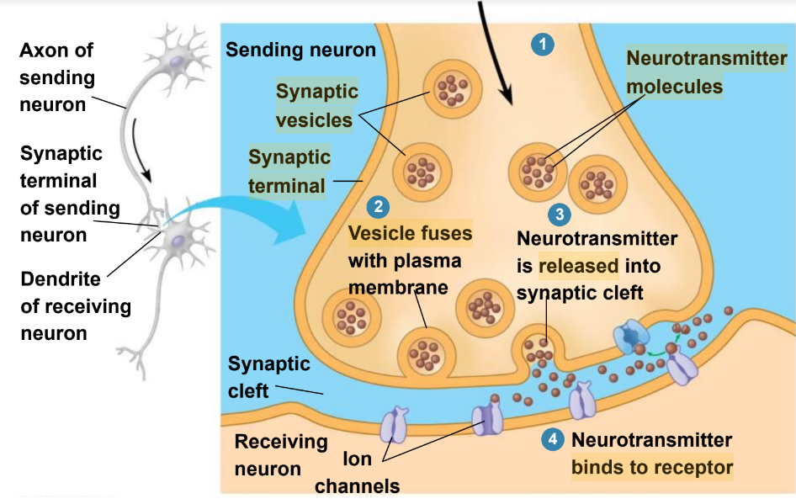
• Figure 28.6 illustrates the events that occur at a typical chemical synapse

Slide 35
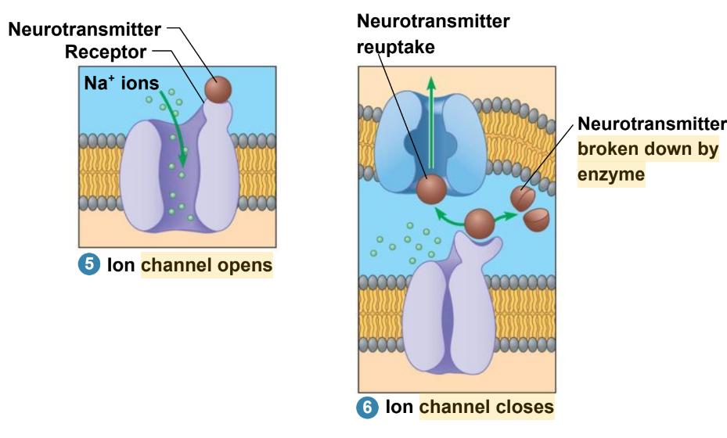

Slide 36
28.7 Chemical synapses enable complex information to be processed
• A neuron may receive information via neurotransmitters from hundreds of other neurons, connecting at thousands of synaptic terminals, to any areas that are not myelinated, including dendrites and cell bodies.
• The inputs can be highly varied because each sending neuron may secrete a different quantity or kind of neurotransmitter.

Slide 37
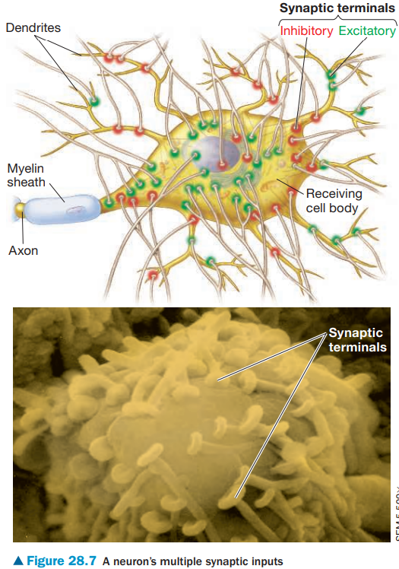

Slide 38
• A receiving neuron’s membrane may receive signals that are both excitatory and inhibitory.
  • Some neurotransmitters excite a receiving cell.
  • Neurotransmitters that open Na+ channels may trigger action potentials in the receiving cell. Such effects are referred to as excitatory.
  • Others inhibit a receiving cell’s activity.
  • Many neurotransmitter open Cl or K channels effects are called inhibitory.
  • The summation of excitation and inhibition determines if a neuron will transmit a nerve signal.

Slide 39
28.8 A variety of small molecules function as neurotransmitters
• Many small, nitrogen-containing molecules are neurotransmitters.
  • Acetylcholine is released by motor neurons to activate skeletal muscles,
    • by other PNS neurons that affect internal organs and glands.
    • by neurons in the CNS that affect memory, learning.
    • Depending on the receptors on receiving cells acetylcholine may be excitatory or inhibitory.
    • It makes skeletal muscles contract but slow the rate of contraction of cardiac muscles.

Slide 40
• Glutamate and GABA are widespread in CNS.
• Glutamate act as excitatory synapse and has role in memory.
• GABA (gamma aminobutyric acid) inhibitory synapses in CNS.

Slide 41
• Biogenic amines are neurotransmitters derived from amino acids and function in the CNS. They include norepinephrine, serotonin and dopamine.
  • norepinephrine, is an excitatory in the PNS also functions as hormone.
  • serotonin and dopamine, affect sleep, mood, and attention, and learning
  • Reduce levels of norepinephrine and serotonin seems to be linked with some types of depression.
  • Lack of dopamine associated with Parkinson's disease, while overactive dopamine associated with schizophrenia.

Slide 42
• Many neuropeptides, which are relatively short chains of amino acids, also serve as neurotransmitters.
• Endorphins
  • are peptides that decrease our perception of pain during times of physical or emotional stress and
  • may be released in response to a wide variety of stimuli, including traumatic injury, muscle fatigue, and even eating very spicy foods.
  • Decrease the sensation of pain and produce feelings of euphoria and other emotional effects.
• Nitric oxide: dissolved gases, during sexual arousal in human males.

Slide 43
Neurotransmitters
Acetylcholine
Glutamate
Biogenic amines
neuropeptides
Nitric oxide
norepinephrine
Endorphins
Serotonin and dopamine
an excitatory in the PNS also functions as hormone.
affect sleep, mood, and attention, and learning
GABA
Excitatory
makes skeletal muscles contract.
- Excitatory synapse
- Has a role in memory
Inhibitory
slow the rate of contraction of cardiac muscles.
inhibitory synapses in CNS
- dissolved gases
- act in sexual arousal in human males.
- released in response to
-traumatic injury
-muscle fatigue
-eating very spicy foods
-Decrease the sensation of pain
-- produce emotional effects.

Slide 44
An Overview of Animal Nervous Systems

Slide 45
28.11 EVOLUTION CONNECTION: The evolution of animal nervous systems reflects changes in body symmetry
• Animals on the earliest branches of the animal evolutionary tree,
such as sponges, lack a nervous system.
• Radially symmetrical animals, such as cnidarians, have nerve net,
weblike system of interconnected neurons extending throughout the body. This nerve net control the counteractions of digestive cavity, movement the tentacles, and other functions.

Slide 46
• Most bilaterally symmetrical animals evolved
• cephalization, the concentration of the nervous system at the head end
  • centralization, the presence of a central nervous system distinct from a peripheral nervous system

Slide 47
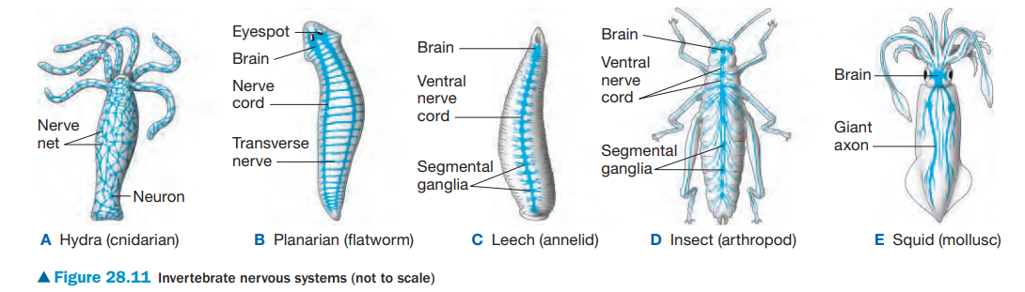

Slide 48
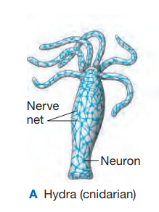
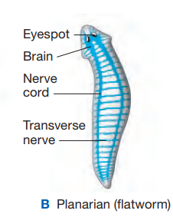
-have a nerve net a diffuse, weblike system of interconnected neurons extending
throughout the body.
-Neurons of the nerve net control the
contractions of the digestive cavity, movement of the tentacles, and other functions.
Planarian:
-the brain, ganglia (groups of neurons) and two parallel nerve cords, elongated bundles of neurons that control movements.
-The transverse nerves coordinate movements between the two sides of the body

Slide 49
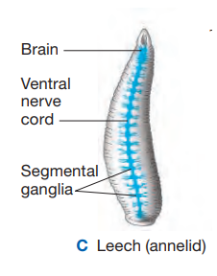
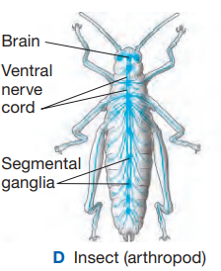
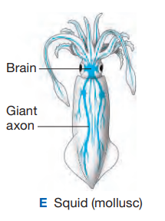
• leeches
brain, a large concentration of neurons
ventral nerve cords arranged segmental ganglia.
ganglion in each body segment.
directs the activity of muscles in its segment of the body.
-It has a brain consisting of several fused ganglia, and the ventral nerve cord has a ganglion in every part of the body
-Each of these nodes directs muscle activity in its own part of the body
-Sessile or slow-moving molluscs, such as clams, have little or no cephalization and simple sense organs.
squid: large brain, complex eyes and rapid signaling along giant axons (up to 1 mm in diameter)

Slide 50
28.12 Vertebrate nervous systems are highly centralized
• In all vertebrates, the central nervous system ( CNS) consists of
  • The brain, the master control center of the nervous system. Brain includes homeostatic centers , sensory centers, center of emotion also sends motor commands to muscles.
  • The spinal cord, a bundle of nervous tissue that runs lengthwise inside the spine, which conveys information to and from the brain and integrates simple responses to certain stimuli.

Slide 51
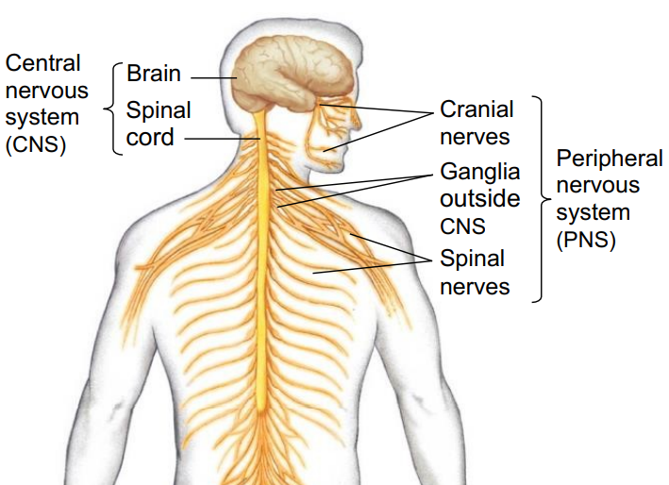

Slide 52
• The brain capillaries allow essential nutrients and oxygen to pass freely into the brain but keep out many chemicals such as metabolic wastes. This selective mechanism, called the blood-brain barrier, maintains a stable chemical environment for the brain.
• Cerebrospinal fluid is found in and around the brain and spinal cord. Supplying nutrient and hormones and carrying out wastes. If the Cerebrospinal fluid become infected by bacteria or viruses, the meninges may become inflamed, a condtion called meningitis
  • Ventricles are spaces in the brain and the central canal in spinal cord filled with cerebrospinal fluid.
• Also protecting the brain and spinal cord are layers of connective tissue called meninges.

Slide 53
• Both brain and spinal cord contain white matter and gray matter.
• White matter composed mainly of axons
• Gray matter composed of neurone cell bodies and supporting glia

Slide 54
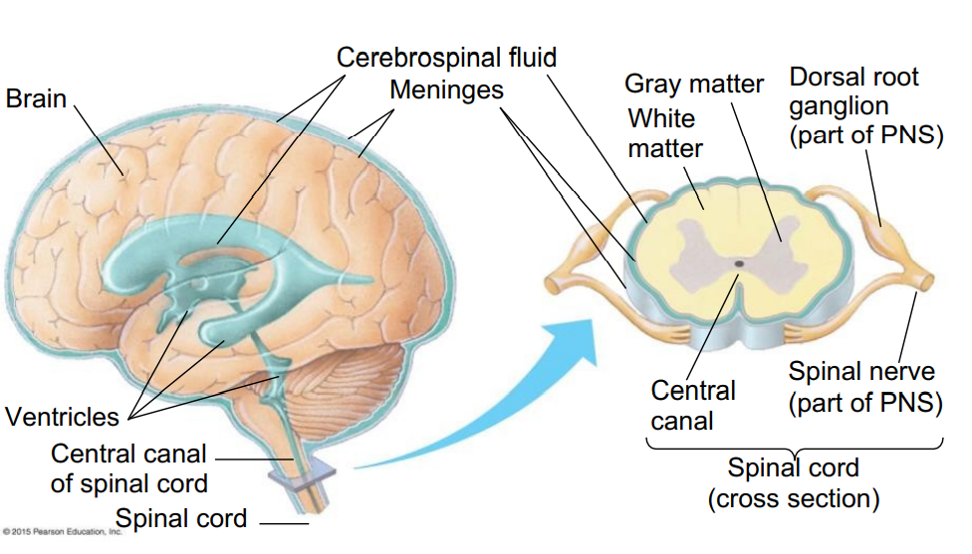

Slide 55
28.13 The peripheral nervous system of vertebrates can be divided into functional components
• The PNS consists of both sensory and motor nerves.
• The motor neuron can be subdivided into two functional components:
The motor system
  • carries signals from the CNS to skeletal muscles, mainly in response to external stimuli, and is mostly voluntary.
2. The autonomic nervous system
  • regulates the internal environment by controlling smooth and cardiac muscles and the organs and glands of the digestive, cardiovascular, excretory, and endocrine systems and is mostly involuntary.

Slide 56
The autonomic nervous system
The parasympathetic division
The sympathetic division
The enteric division
primes the body for activities that gain and conserve energy for the body.
prepares the body for intense, energy-consuming activities.
consists of networks of neurons in the digestive tract, pancreas, and gallbladder that control secretion and the activity of smooth muscles that produce peristalsis.
"fight or flight" Inhibit the digestive organe, increase the heart rate ,stimulate the release of glucose from the liver and induce the adrenal gland to secrete epinephrine and norepinephrine.
"rest and digest” stimulate the digestive organs, decrease the heart rate and increase glycogen production by liver.
example
example

Slide 57
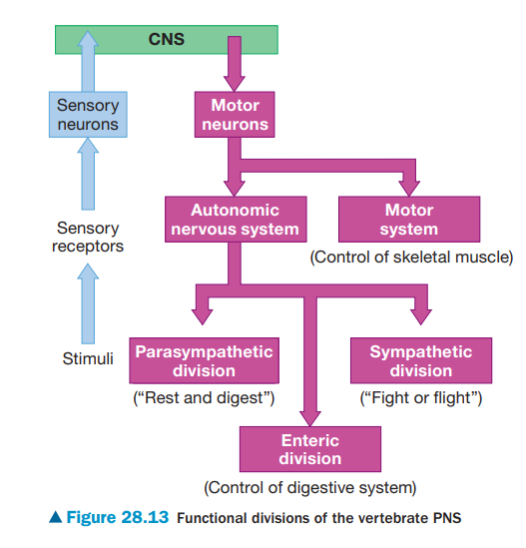

Slide 58
28.14 The vertebrate brain develops from three anterior bulges of the neural tube
• The vertebrate brain evolved by the enlargement and subdivision of the
  • forebrain
  • midbrain
  • hindbrain.
• In the course of vertebrate evolution, the forebrain and hindbrain gradually became subdivided structurally and functionally into specific regions.

Slide 59
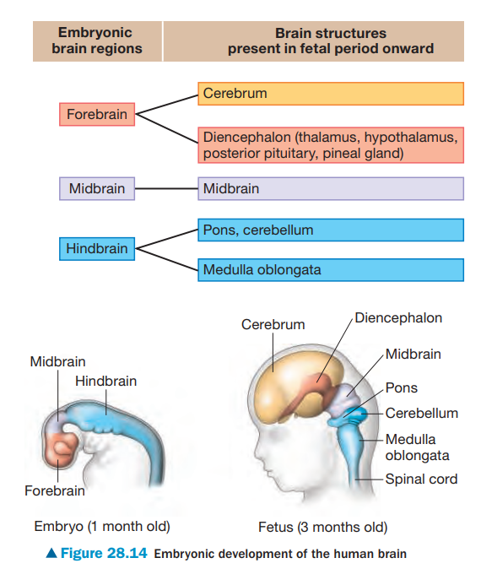

Slide 60
In birds and mammals, the cerebrum
  • is much larger and
  • correlates with their sophisticated behavior.
  • The cerebrum’s outer region called(cerebral cortex)
  • enlarges during mammalian brain development and
    • is vital for perception, voluntary movement, and learning

Slide 61
The Human Brain

Slide 62
28.15 The structure of a living supercomputer: The human brain
• The human brain is
• more powerful than the most sophisticated computer and
• composed of three main parts:
forebrain,
2. midbrain, and
3. hindbrain.

Slide 63
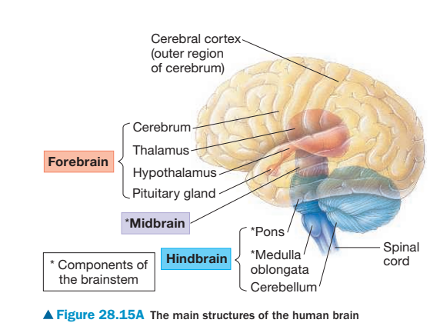
• Figure 28.15A shows the three embryonic brain regions in their fully developed adult form.

Slide 64
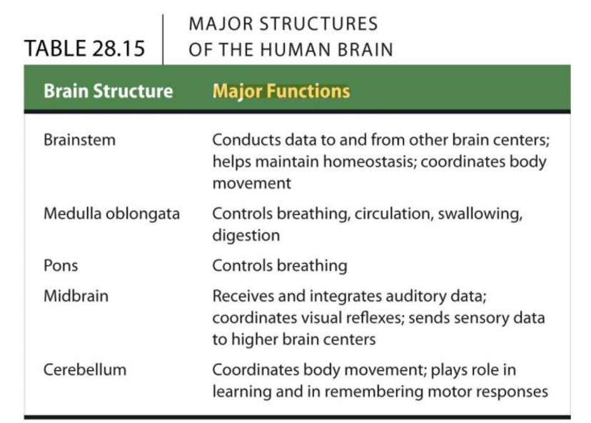
• Table 28.15 summarizes the major structures and functions of the brain

Slide 65
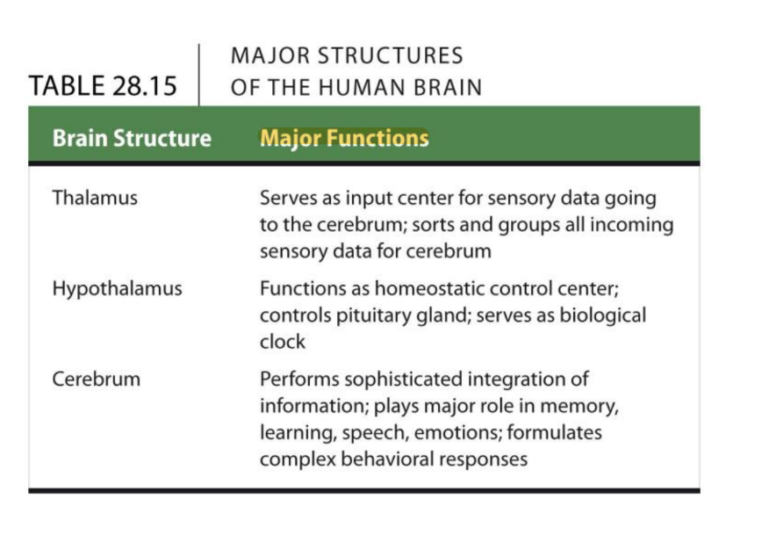

Slide 66
• The midbrain and subdivisions of the hindbrain, together with the thalamus and hypothalamus of the forebrain,
  • function mainly in conducting information to and from higher brain centers.
  • regulate homeostatic functions,
  • keep track of body position, and
  • sort sensory information

Slide 67
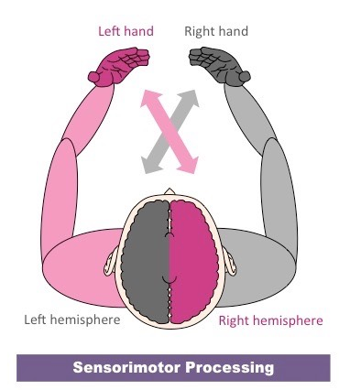
• The cerebrum, the largest and most complex part of our brain, consists of right and left cerebral hemispheres.
  • A thick band of nerve fibers called the corpus callosum facilitates communication between the hemispheres.
  • Under the corpus callosum, groups of neurons called the basal nuclei are important in motor coordination
Ref:https://shortest.link/8tW4

Slide 68
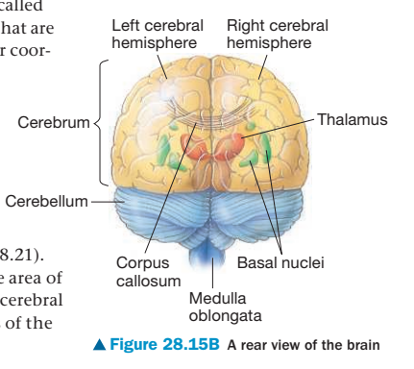

Slide 69
28.16 The cerebral cortex controls voluntary movement and cognitive function
• The cerebral cortex
  • is less than 5 mm thick and
  • accounts for 80% of the total human brain mass.
• Researchers have identified a number of functional areas within each lobe
• The cerebral cortex contains four lobes named for a bone close to the skull: the frontal, parietal, temporal, and occipital lobes.

Slide 70
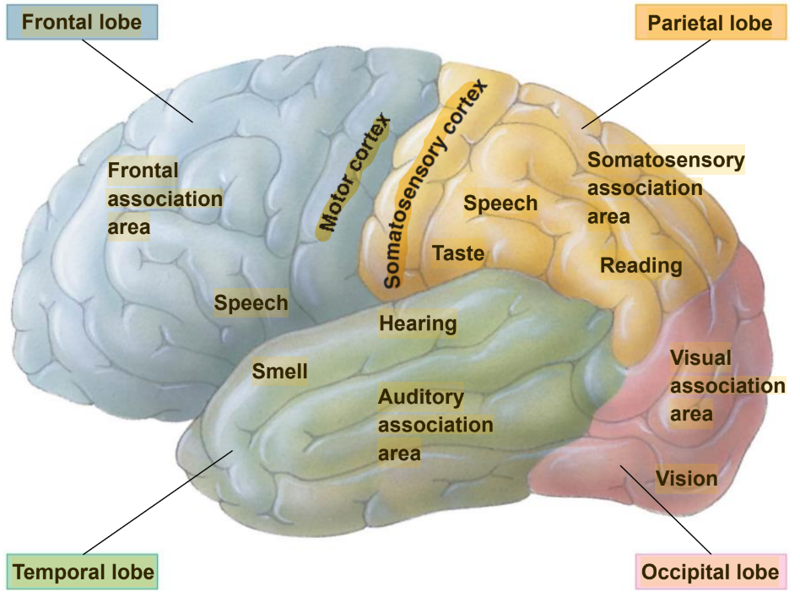


Slide 71
• Two areas of known function form the boundary between the frontal and parietal lobes.
  The motor cortex mainly sends commands to skeletal muscles, signaling appropriate responses to sensory stimuli.
  2. The somatosensory cortex receives and partially integrates signals from touch, pain, pressure, and temperature receptors throughout the body.
• The cerebral cortex also has centers that receive and begin processing sensory information concerned with vision, hearing, taste, and smell.

Slide 72
• Association areas
• are concerned with higher mental activities such as reasoning and language and
• make up most of the cerebrum.

Slide 73
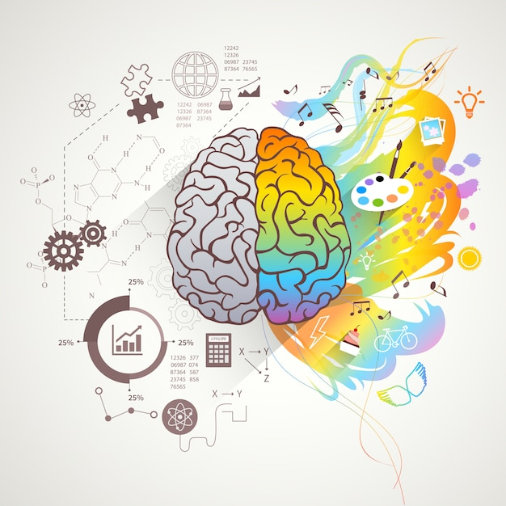
• In most people, the left cerebral hemisphere (logical) becomes adept at language, logic, and mathematical operations, as well as detailed skeletal motor control and processing of fine visual and auditory details.
• The right cerebral hemisphere (creative) is stronger at spatial (describe things relating to area)relations, pattern and face recognition, and nonverbal thinking.
• This difference in function between the right and left hemisphers is known as lateralization.
Ref:https://shortest.link/8n1t

Slide 74
You should now be able to
Describe the structural and functional subdivisions of the nervous system.
Describe the three parts of a reflex, distinguishing the three types of neurons that may be involved in the reaction.
3. Describe the structures and functions of neurons and myelin sheaths.
4. Define a resting potential and explain how it is created.
5. Explain how an action potential is produced and the resting membrane potential restored.

Slide 75
You should now be able to
6. Compare the structures, functions, and locations of electrical and chemical synapses.
7. Compare excitatory and inhibitory neurotransmitters .
8. Describe the types and functions of neurotransmitters known in humans.
9. Explain how drugs can alter chemical synapses.
10. Describe bias in the reporting of scientific results.
11. Describe the diversity of animal nervous systems and provide examples.

Slide 76
You should now be able to
12. Describe the general structure of the brain, spinal cord, and associated nerves of vertebrates.
13. Compare the functions of the motor nervous system and autonomic nervous system.
14. Compare the structures, functions, and interrelationships of the parasympathetic, sympathetic, and enteric divisions of the peripheral nervous system.
15. Explain how the vertebrate brain develops from an embryonic tube.

Slide 77
You should now be able to
16. Describe the main parts and functions of the human brain.
17. Explain how injuries, illness, and surgery provide insight into the functions of the brain.
18. Explain how fMRI scans help us understand brain functions.
19. Explain how the brain regulates sleep and arousal.
20. Describe the structure and functions of the limbic system
21. Describe the causes, symptoms, and treatments of schizophrenia, depression, Alzheimer’s disease, Parkinson’s disease, and chronic traumatic encephalopathy.

