Slide 1



Chapter 33
Control Systems in Plants
* The slides are copied from the original slides of the course with some additions from Ms. Halima Rais
* تم استخدام العرض التقديمي الخاص بالمادة الأصلية مع إضافات من الشارحة حليمة ريس

Slide 2
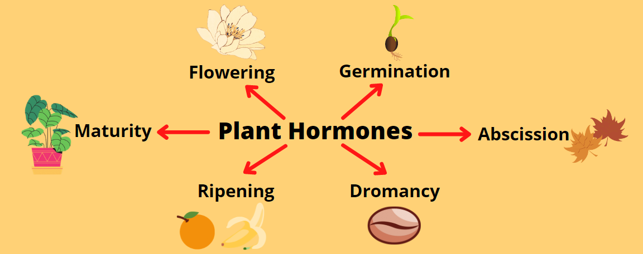
PLANT HORMONES
Ref:https://shortest.link/6qQp

Slide 3
33.1 SCIENTIFIC THINKING: A series of experiments by several scientists led to the discovery of a plant hormone
• Any plant growth that results in plant organs curving toward or away from stimuli is called a tropism.
• The growth of an organ in response to light is called phototropism.
• Phototropism has an obvious advantage, directing growing seedlings and the shoots of mature plants toward the sunlight that drives photosynthesis.

Slide 4


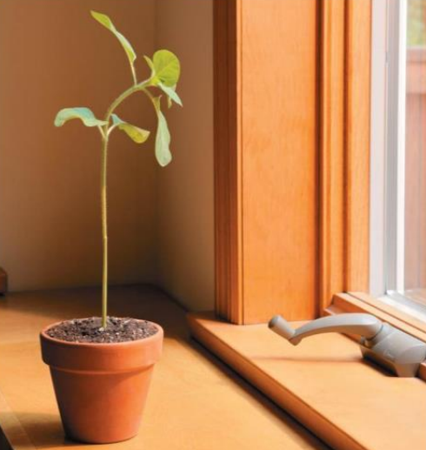

Slide 5
• Plants, like animals, use hormones to control body wide responses.
• A hormone is a chemical signal produced in one part of the body and transported to other parts, where it acts on target cells to change their functioning.

Slide 6
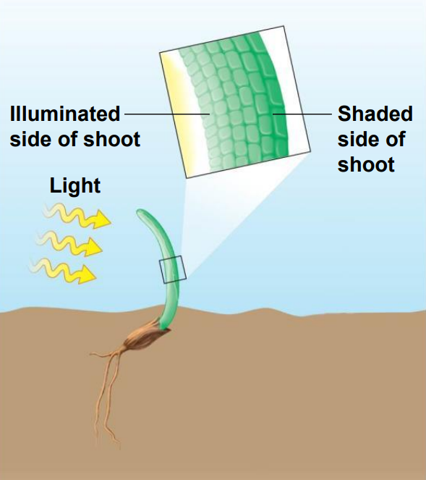
• In the late 1800s, 1-Charles Darwin and his son Francis conducted some of the earliest experiments on phototropism.
• They observed : that grass seedlings could bend toward light only if the tips of their shoots were present.

Slide 7
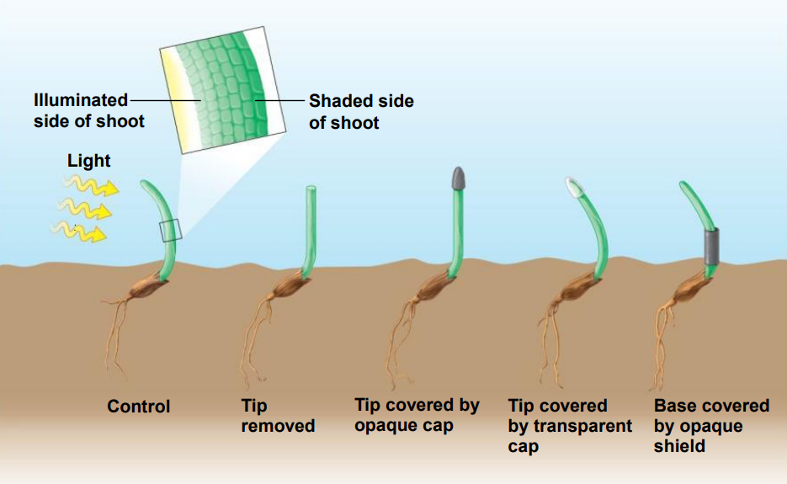
• The five grass plants in Figure 33.1B summarize the Darwins’ findings

Slide 8
• The Darwins’experiments:
1- First, a control plant bends toward the light.
2-When plant tips were removed, plants did not grow toward light.
3-When plant tips were covered with an opaque cap, they did not grow toward light.
4-When plant tips were covered with a clear tip, they did grow toward light.
5- the plant bends toward the light

Slide 9
The Darwins concluded that
The tip of the shoot was responsible for sensing light.
They also recognized that the growth response, occurs in cells that are below the tip.
Therefore
they hypothesized that some chemical signal must be transmitted from the tip downward to the growth region of the shoot.

Slide 10
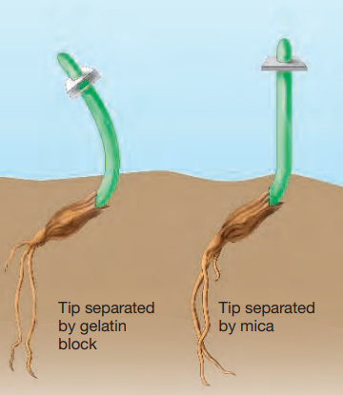
A few decades later, 2-Peter Boysen-Jensen conducted experiments that showed that :chemical signals produced in shoot tips were responsible for phototropism.
• Jensen’s experiment:
• When a gelatin block that allowed chemical diffusion was inserted below the shoot tip, plants grew toward light.
• When a mica block that prevented chemical diffusion was inserted below the shoot tip, plants did not grow toward light.

Slide 11
• These experiment supported the hypothesis that the signal for phototropism is a chemical that diffuses through the plant body.

Slide 12
3-Frits Went isolating the chemical signal
• Plant tips were placed on an agar block to allow the chemical signal molecules to diffuse from the plant tip to the agar.
1- he centered the treated agar blocks on the cut tips of seedling. These plants grew straight upward also grew faster than the control seedling.
• Went conclude that the agar had absorbed the chemical signal in the shoot tip and that the chemical has passed into the shoot and stimulated it to grow.

Slide 13
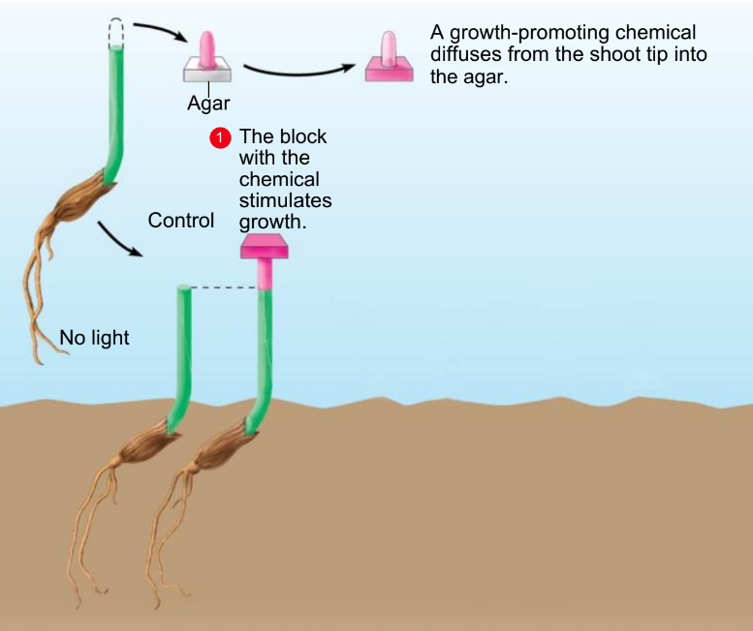

Slide 14
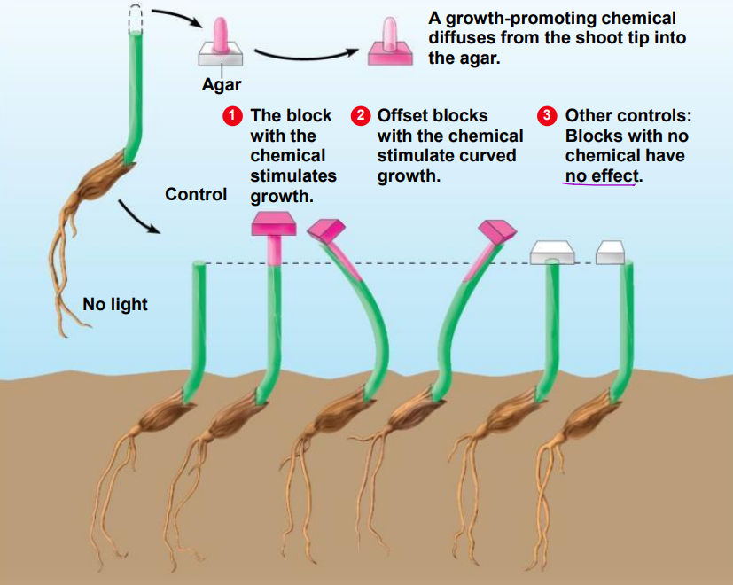
2- he placed agar blocks off center of tip seedling these plants bent away from the side with the chemical agar , as thought growing toward light.
3- control seedling with blank agar blocks have no effect.

Slide 15
Went concluded that
the agar block contained a chemical produced in the shoot tip
this chemical stimulated growth as it passed down the shoot
a shoot curved toward light because of a higher concentration of the growth-promoting chemical on the darker side.
The chemical signal responsible for phototropism is a hormone he called auxin.

Slide 16
• Based on these early experiments, botanists hypothesized that an uneven distribution of auxin moving down from the shoot tip causes cells on the darker side to elongate faster than cells on the brighter side.
• But studies with plants other than grass shoots do not always support this hypothesis.
• There is, however, a greater concentration of substances that may act as growth inhibitors on the lighted side of a stem.

Slide 17
Conclusion | The Experience | Scientist name
1- The tip of the shoot was responsible for sensing light. 2-chemical signal must be transmitted from the tip downward to the growth region of the shoot. | He performed different procedures on five grass seedlings | Charles Darwin and Francis
These experiment supported the hypothesis that the signal for phototropism is a chemical that diffuses through the plant body. | Show the transfer of the chemical signal from the shoot tip to the lower part of the plant By inserting a gelatin block in one seedling and a mica block in another seedling. | Peter Boysen-Jensen
1- the agar block contained a chemical produced in the shoot tip 2-this chemical stimulated growth as it passed down the shoot 3-a shoot curved toward light because of a higher concentration of the growth-promoting chemical on the darker side. 4-The chemical signal responsible for phototropism is a hormone he called auxin | 1-He placed the shoot tips on the agar blocks 2- he put the agar blocks on seedlings without a tips 3- he put the agar blocks on one side of the other seedlings without a tips 4- He compared the results and wrote the conclusion. | Frits Went

Slide 18
33.2 Botanists have identified several major types of hormones
• Plant hormones are produced in very low concentrations, but in a tiny amount can have a profound effect on growth and development.
• The binding of hormones to a specific cell-surface receptor triggers a signal transduction pathway that
that amplifies the hormonal signal and leads to one or more responses within the cell.

Slide 19
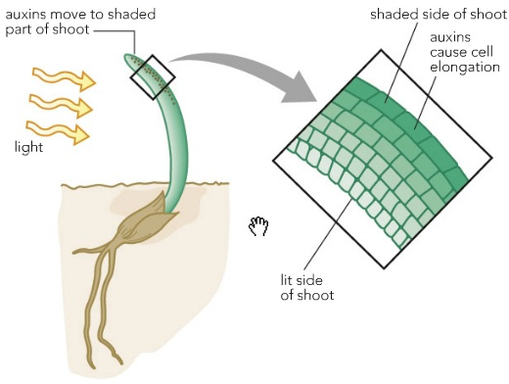
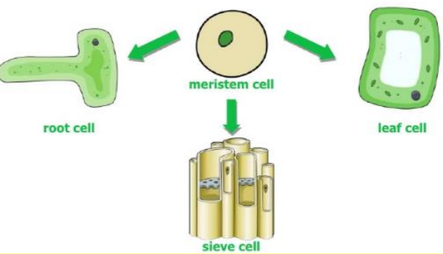
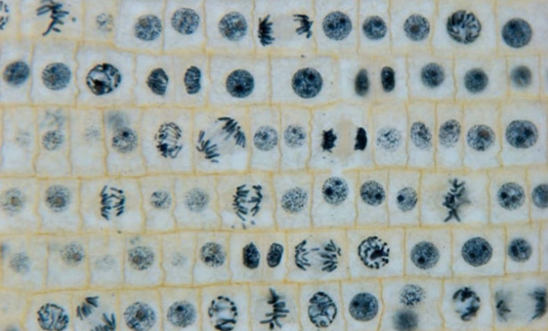
• In general, plant hormones control whole-body activities such as growth and development by affecting the
elongation
differentiation of cells.
division
Ref:https://shortest.link/6MpS
Ref:https://shortest.link/6tao
Ref:https://shortest.link/6Mou

Slide 20
• Plant biologists have identified five major types of plant hormones, all of which stimulate or inhibit cell division and elongation, thereby influencing growth.
• We also know that there are important plant hormones beyond those listed in the table. For example, brassinosteroids induce cell elongation and division in stems ad seedlings. Their effect is similar to auxin.

Slide 21
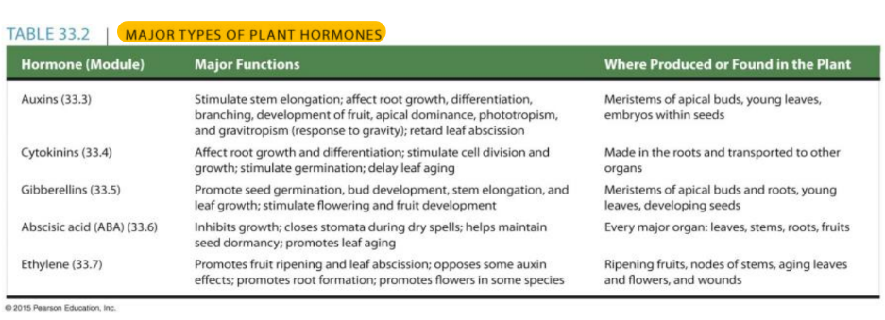

Slide 22
• As Table 33.2 indicates, each hormone can produce a variety of effects, depending on
• its site of action,
• its concentration, and
• the developmental stage of the plant.

Slide 23
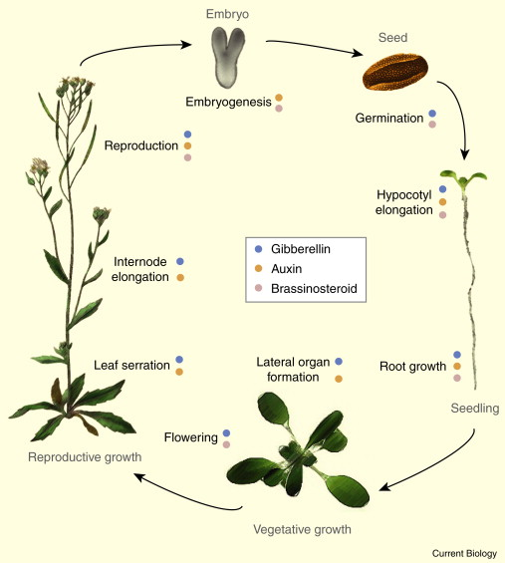
• In most situations, no single hormone acts alone. Instead, it is usually the balance of several hormones (their relative concentrations) that controls the growth and development of a plant.
Ref: https://shortest.link/6LXc

Slide 24
33.3 Auxin stimulates the elongation of cells in young shoots
• Auxin is the term for any chemical substance that promotes seedling elongation (although auxins have multiple functions in flowering plants).
• Indoleacetic acid (IAA) is the major natural auxin found in plants and
• Auxin is produced in apical meristems at the tips of shoots.

Slide 25
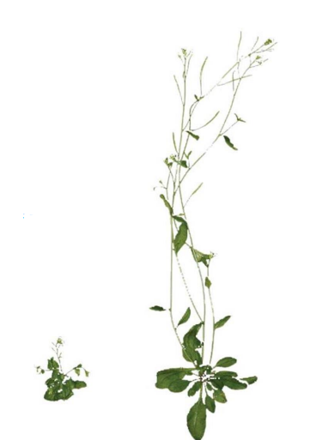

• Figure 33.3A shows the effect of auxin on a mustard plant called Arabidopsis thaliana.
• The plant on the right is a wild-type Arabidopsis.
• The plant on the left contains a mutation in the auxin gene. The result of this mutation is a lack of auxin protein, which in turn results in stunted growth

Slide 26
• Auxin stimulating cell elongation and causing stems and roots to length.
• Auxin induces cell division.
• Auxin produced in shoot tips helps control the overall branching of growing plant.
• A commercially important effect of auxin is the promotion of fruit development.
• A natural auxin called indolebutyric acid (IBA) is used to promote the development of roots during transplantation.

Slide 27
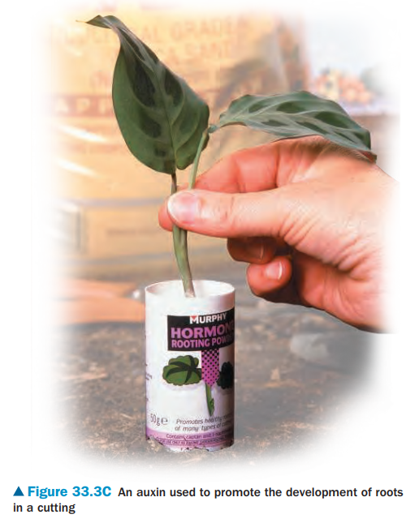

Slide 28
• Auxin promotes cell elongation in stems only within a certain concentration range.
• Concentration of auxin and site of activity are important to auxin’s effects
• In moderate concentrations, auxin promotes cell elongation in stems
• In high concentrations, auxin reduces cell elongation in stems
• Auxins affects cell elongation in roots at lower concentrations

Slide 29
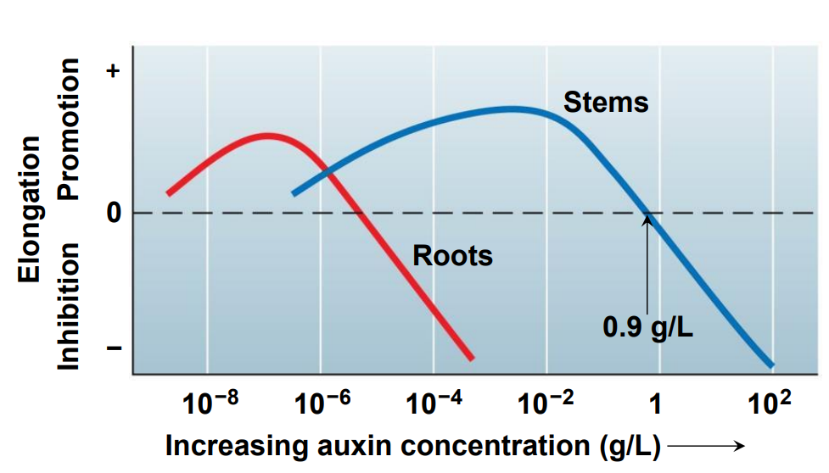

Slide 30
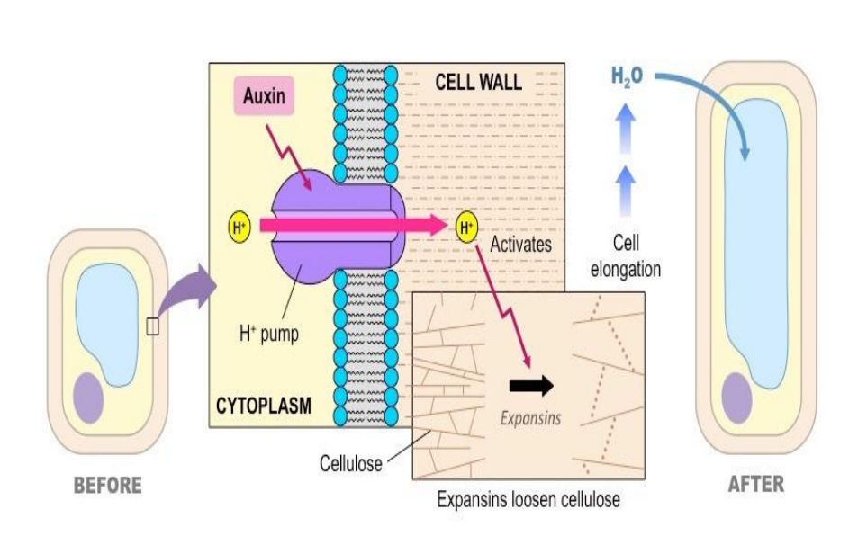
How does auxin make plant cells elongate?
hypothesis for the action of auxin –Auxins stimulate proteins within the plasma membrane to pump protons
(H ions) into the cell wall. This lower the pH, which in turn activates enzyme that weaken connections between cellulose fibers. More water can enter the cell wall causing it to elongate.

Slide 31
33.4 Cytokinins stimulate cell division
Cytokinins
• are hormones produced in actively growing organs such as roots, embryos, and fruits. that promote cytokinesis, or cell division and cell differentiation.
• They also retard the aging of leaves and flowers by inhibiting protein breakdown.
• are made in the roots and reach target tissues in stems by moving upward in xylem sap.

Slide 32
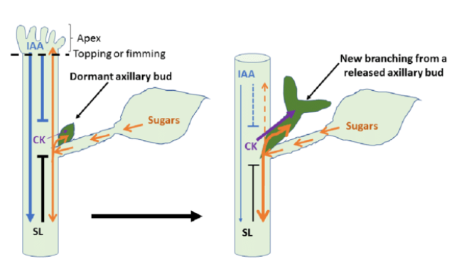
• Cytokinins and auxins (antagonistically) interact in the control of apical dominance, the ability of the terminal bud of a shoot to suppress the growth of the axillary buds.
Ref:https://shortest.link/6Fb2

Slide 33
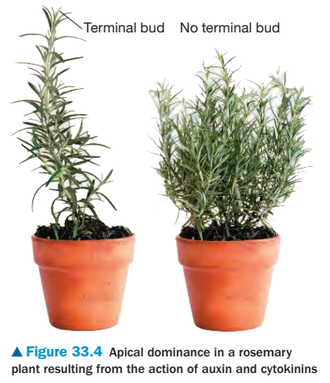
• In the plant on the left apical dominance inhibited the growth of the axillary buds. As a result the shoot grew in height but did not branch.
• In the plant on the right, the lack of terminal bud resulted in the activation of the axillary buds making the plant grow branches

Slide 34
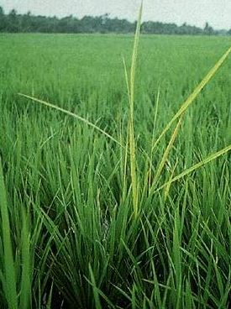
33.5 Gibberellins affect stem elongation and have numerous other effects
• Gibberellins were named for a genus of fungi that caused rice seedlings to grow so tall and spindly that they toppled over before producing grain.
• Gibberellins: young roots and leaves are major sites of gibberellins production.
• one of the main effects is stimulate cell elongation and cell division in stems and leaves.
• More than 100 different gibberellins have been identified in plants, although any particular species uses only a few.
• Certain dwarf plant varieties grow to normal height after treatment with gibberellin.
Bakanae Disease of rice
https://shortest.link/6Zvv

Slide 35
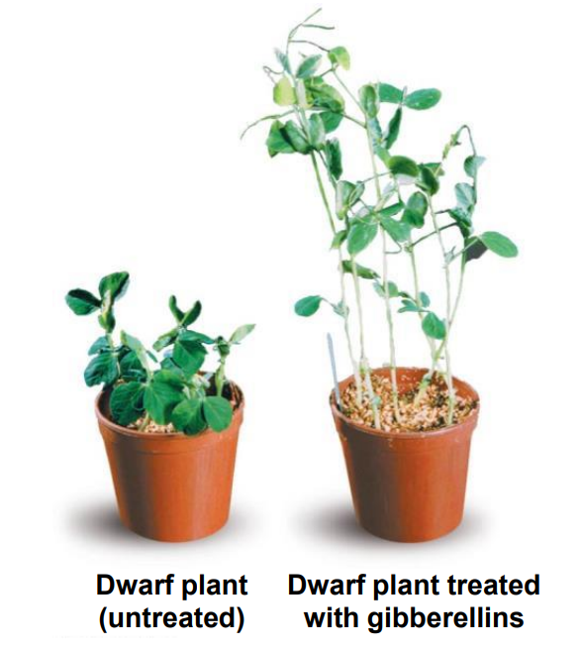


Slide 36
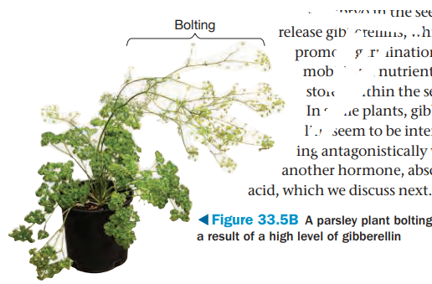
• Gibberellin-induced stem elongation can also cause bolting, the rapid growth of a floral stalk.

Slide 37
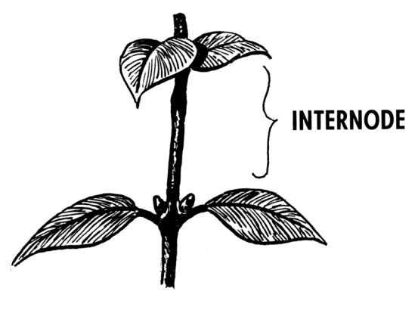
• In many plants, both auxins and gibberellins must be present for fruit to develop.
• The most important commercial application of gibberellins is in the production of the Thompson variety of seedless grapes.
• Gibberellins cause internodes to elongate.
• As a result, the grapes treated with gibberellins grow larger and farther apart in a cluster (which increases air flow and decreases rotting), traits desired by most consumers.
Ref:https://shortest.link/6HNh

Slide 38
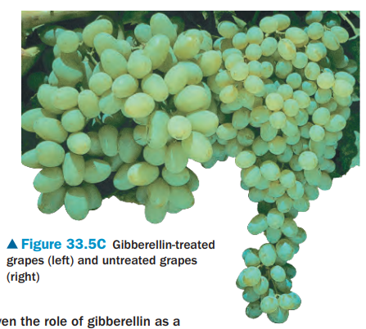

Slide 39
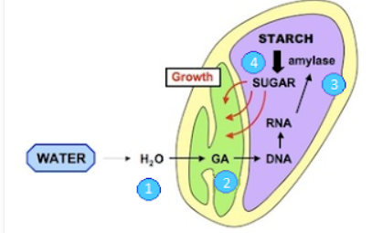
• Gibberellins also promote seed germination in many plants. • Gibberellins in seeds are probably the link between environment and growth.
• For example, when water becomes available to grass seed ,it causes the embryo in the seed to release gibberellins, which promote germination.
Ref:https://shortest.link/72aQ

Slide 40
33.6 Abscisic acid inhibits many plant processes
• Abscisic acid (ABA) is a plant hormone that slows growth.
• High concentrations of ABA promote seed dormancy.
• ABA must be removed or inactivated for germination to occur.
• For many plants, the ratio of ABA to gibberellins therefore determines whether the seed will remain dormant or germinate (antagonistically interact).
• ABA is also the primary internal signal that enables plants to withstand drought.

Slide 41
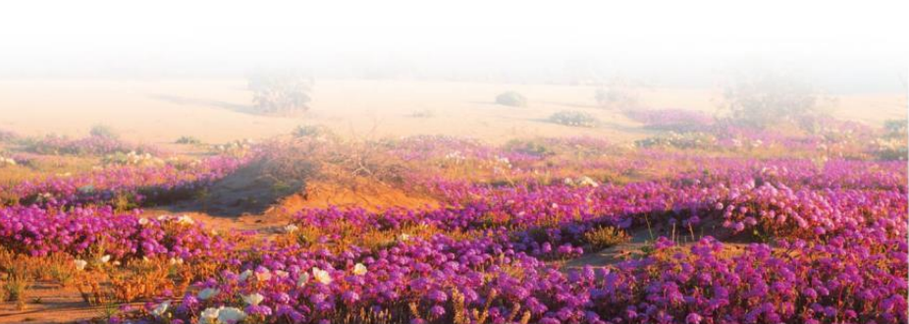

Slide 42
33.7 Ethylene triggers fruit ripening and other aging processes
•Ethylene
• Plants produce ethylene, which triggers
1- fruit ripening and programmed cell death.
2-Ethylene is also produced in response to stresses such as drought, flooding, injury, or infection.

Slide 43
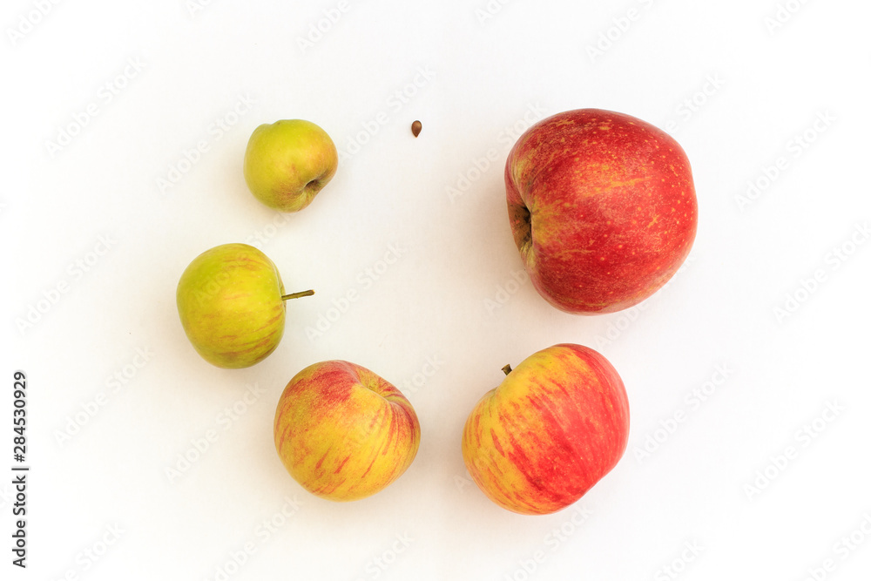
• The ripening process includes the enzymatic breakdown of cell walls, which softens the fruit and conversion of starches and acids to sugars which makes the fruit sweet.

Slide 44
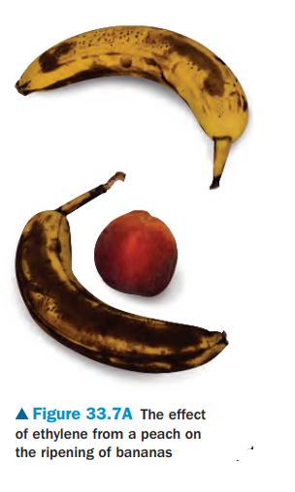
• You can make some fruits ripen faster if you store them in a bag so that the ethylene gas accumulates.
• Figure 33.7A shows two unripe bananas that were stored for the same time period in bags under different conditions: alone and with an ethylene releasing peach.
• The ethylene released by the ripening peach resulted in a riper (darker) banana

Slide 45
• On a commercial scale, many kinds of fruit— tomatoes, for instance—are often picked green and then ripened in huge storage bins into which ethylene gas is piped.
• In other cases, growers take measures to slow down fruit ripening. Stored apples are often flushed with CO2, which
• inhibits ethylene synthesis and prevents ethylene from accumulating.

Slide 46
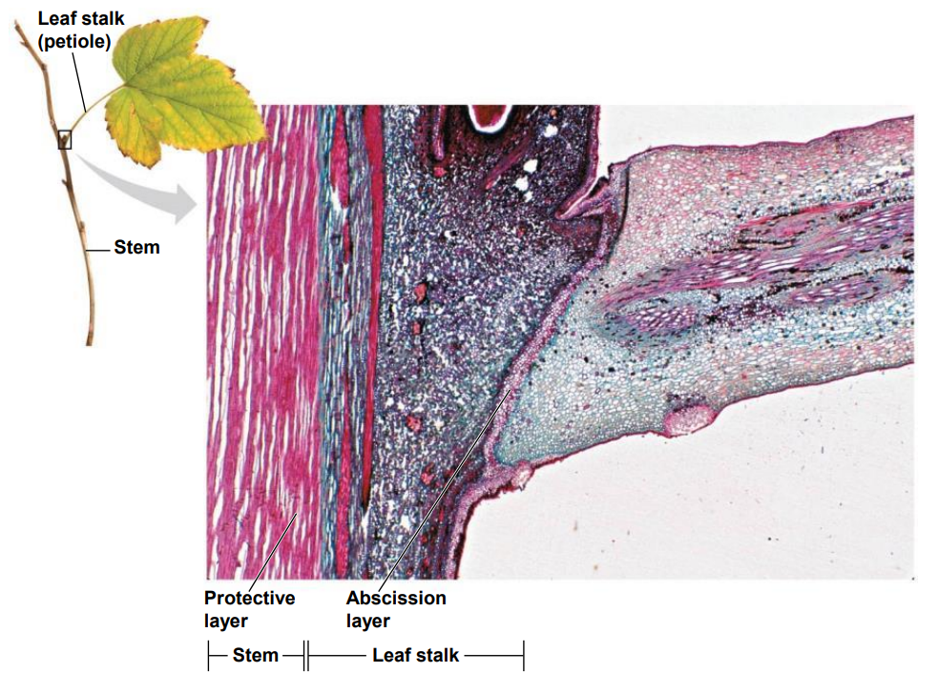
• A changing ratio of auxin to ethylene, triggered mainly by shorter days, probably causes
• autumn color changes and
• the loss of leaves from deciduous trees.
• When an autumn leaf falls, the base of the leaf separates from the stem.
• The separation region is called the abscission layer.
• The leaf drops off when its weight splits the abscission layer apart.

Slide 47
RESPONSES TO STIMULI

Slide 48
33.9 Tropisms orient plant growth toward or away from environmental stimuli
• Tropisms are responses that cause plants to grow in response to environmental stimuli
• Positive tropisms cause plants to grow toward a stimulus
• Negative tropisms cause plants to grow away from a stimulus
• Plants respond to various environmental stimuli.
• Phototropism is a response to light.
• Gravitropism is a response to gravity.
• Thigmotropism is a response to touch.

Slide 49
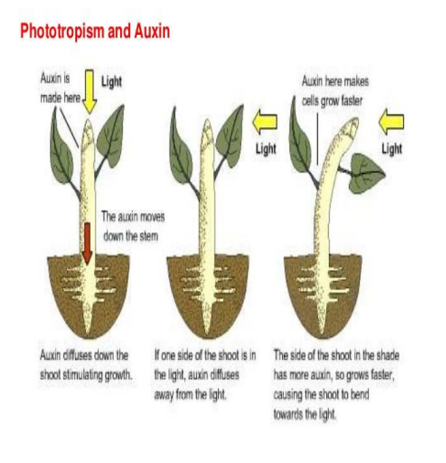
Response to light
• The growth of plant shoot toward light is known positive phototropism.
• The mechanism for phototropism is grater rate of auxin cause cell elongation on the darker side of the stem.

Slide 50
The hypothesis
• illuminating a shoot from one side cause auxin to migrate across the shoot tip from the bright side to the dark side.

Slide 51
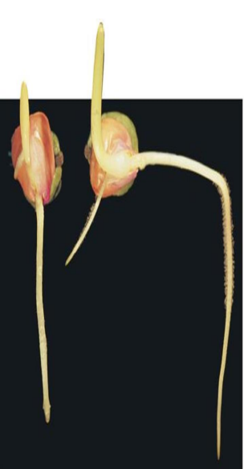

Response to gravity
• Gravitropism: the direction growth of plant in response to gravity. Shoots grow upward and roots grow downward • Results: the one on the left was untouched, on the right the shoot had turned back upward, exhibiting a negative response to gravity, and the root had turned down, exhibiting positive gravitropism.

Slide 52
The hypothesis
• A higher auxin concentration on the lower side of a root inhibits cell elongation. As cells on the upper side continue to elongate, the root curves downward. This tropism continues until the root is growing straight down. (positive gravitropism).
• Gravitropism is an important adaptation, making the shoot of a germinating plant grow upward into the light and the root grow into the soil.

Slide 53
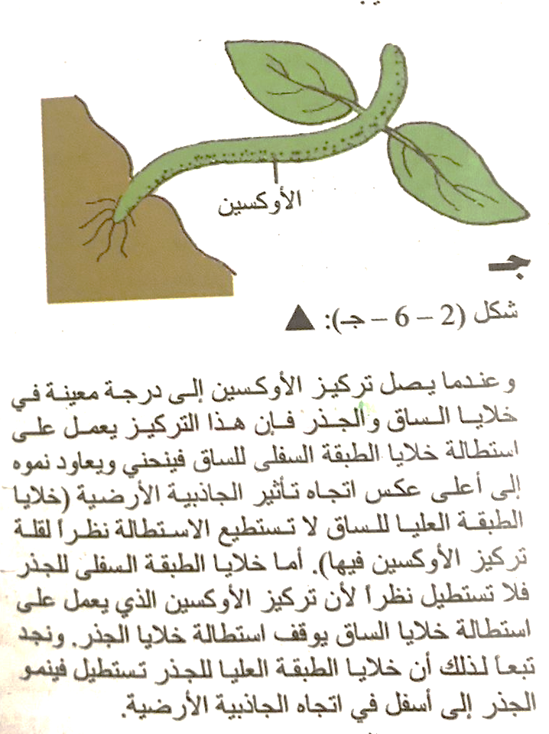
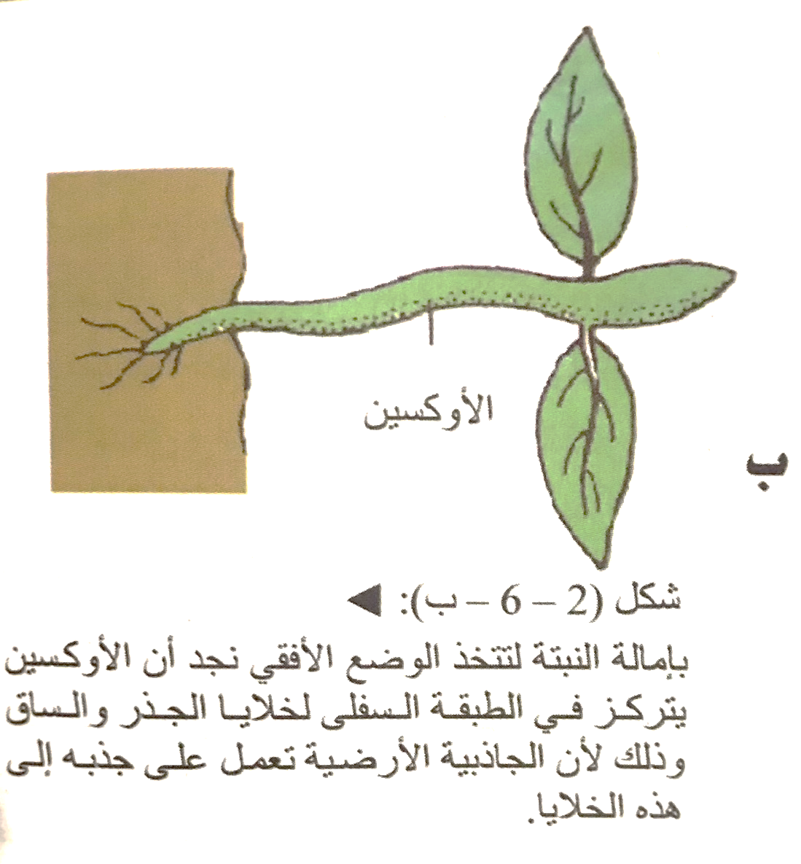
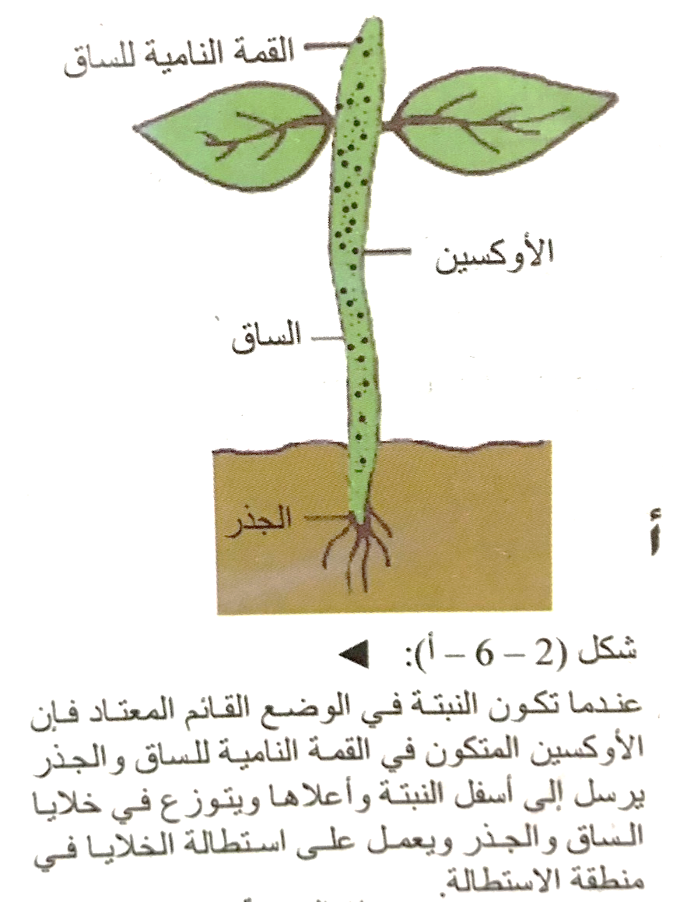
المرجع: باعـشـن. نبيه عبـدالـرحـمـن
مقدمة علم الحياة ج٢ / نبيه عبدالرحـمـن بـاعـشـن؛ أحمد نبيل أبـو خـطـوة؛ حـسـن فلمبان - جدة، ١٤٢٨هـ

Slide 54
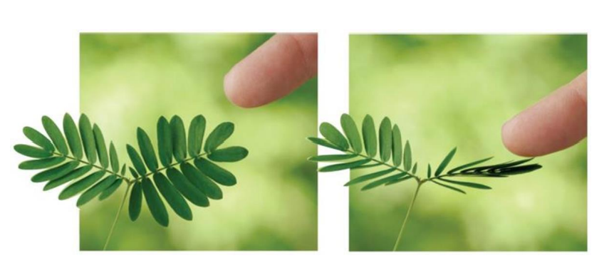
Response to touch
• Thigmotropism: directional growth in response to touch.

Slide 55
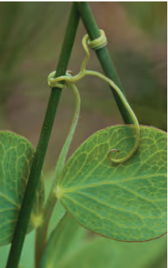
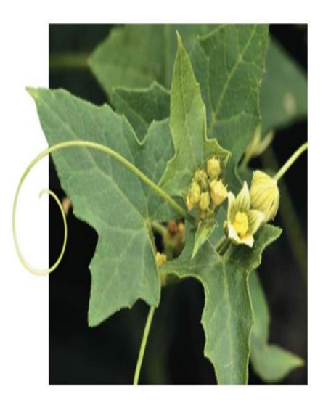

The hypothesis
• The tendril grows straight until it touches an object. Contact stimulates the cell on opposite side to grow at different rates (slower in contact area) making the tendril coil around the support

Slide 56
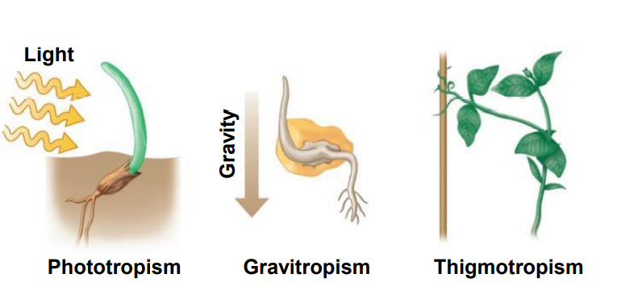

Slide 57
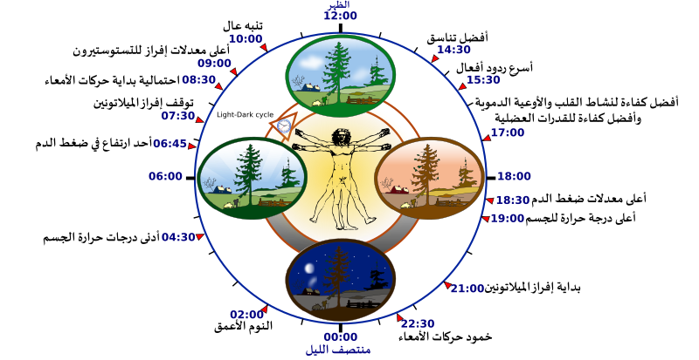
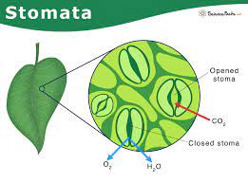
33.10 Plants have internal clocks
• Plants display rhythmic behavior, including the
• opening and closing of stomata
• folding and unfolding of leaves and flowers “sleep movements”
• Some of these cyclic variations continue even under artificially constant conditions, implying that plants have a built-in ability to sense time.
Ref:https://shortest.link/75zS
Ref:https://shortest.link/7r5a

Slide 58
• Circadian rhythms are innate biological cycles of approximately 24 hours.
A circadian rhythm persists even when an organism is sheltered from environmental cues.
• A bean plant, exhibits sleep movements at about the same intervals even if kept in constant light or darkness.
• Circadian rhythms occur with or without external stimuli such as sunrise and sunset but controlled by internal timekeepers called biological clocks.
Biological clock continues to mark time in the absence of environmental cues, it requires daily signals from the environment to remain tuned to a period of exactly 24 hours.

Slide 59
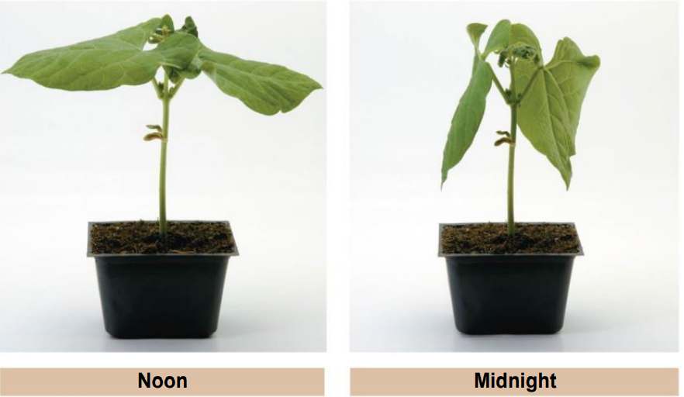

Slide 60
• Research on a variety of organisms indicates that circadian rhythms are controlled by internal timekeepers known as biological clocks.
• The light/dark cycle of day and night provides the cues that usually keep biological clocks precisely synchronized with the outside world.

Slide 61
• Just what is a biological clock?
• In humans and other mammals, the clock is located within a cluster of nerve cells in the hypothalamus of the brain.
• But for most other organisms, including plants, we know little about where the clocks are located or what kinds of cells are involved.
• A leading hypothesis is that biological timekeeping in plants may involve “clock genes” that synthesize a protein that regulates its own production through feedback control.

Slide 62
• After the protein accumulates to sufficient concentration , it turn off its own gene. When the concentration of the protein fall transcription restarted. The result would be cycling of the protein concentration over the a roughly 24 hour.
• Temperature has a significant effect on most metabolic process, it has little effect on biological clocks and circadian rhythms they control.

Slide 63
• It is essential to distinguish between the clock and the processes it controls.
• You could think of the sleep movements of leaves as the “hands” of a biological clock, but they are not the essence of the clockwork itself.
• We can interfere with an organism’s rhythmic activity, but its biological clock goes right on ticking.

Slide 64
33.11 Plants mark the seasons by measuring photoperiod
• Biological clocks can influence seasonal events, including
• flowering,
• seed germination, and
• the onset and ending of dormancy.
• The environmental stimulus that plants most often use to detect the time of year is called photoperiod,
the relative lengths of day and night.

Slide 65
• Plants whose flowering is triggered by photoperiod fall into two groups:
Short-day plants
Long-day plants
day-neutral
flower
flower
flower
when light periods lengthen.
in late spring or early summer
when they
reach a certain stage of maturity, regardless of day length.
when light periods shorten.
in the late summer, fall, or winter
such as
such as
such as
chrysanthemums and poinsettias
spinach, lettuce, and many cereal grains
dandelions,
tomatoes, and rice

Slide 66
• In the 1940s, researchers discovered that flowering and other responses to photoperiod are actually controlled by the length of continuous darkness, not the length of continuous daylight. That is,
• “short-day” plants will flower only if it stays dark long enough, and
• “long-day” plants will flower only if the dark period is short enough.
Therefore, it would seem more appropriate to call the two types “long-night” plants and “short-night” plants.
• However, the day-length terms are embedded firmly in the literature of plant biology and so will be used here.

Slide 67

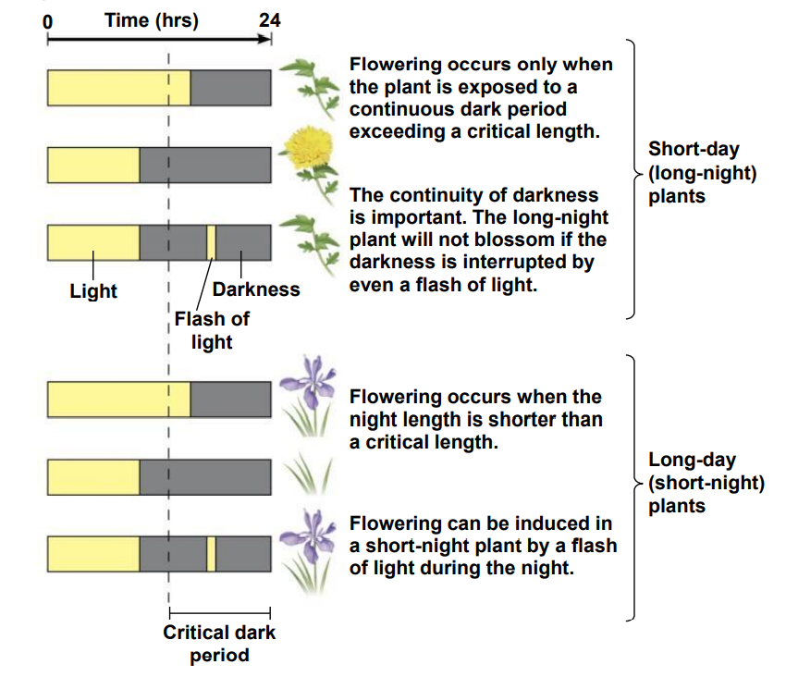
• Figure 33.11
• illustrates the evidence for the night-length effect and shows the difference between the flowering response of a short-day plant and a long-day plant.

Slide 68
• Florists apply this information about short-day plants to bring us flowers out of season.
• Every species of plant has a critical night length, but how that critical night length affects flowering varies with the type of plant.
• In short-day plants, the critical night length is the minimum number of hours of darkness required for flowering; less darkness prevents flowering. • In long-day plants, this critical night length is the maximum number of hours of darkness required for flowering; less darkness promotes flowering.

Slide 69
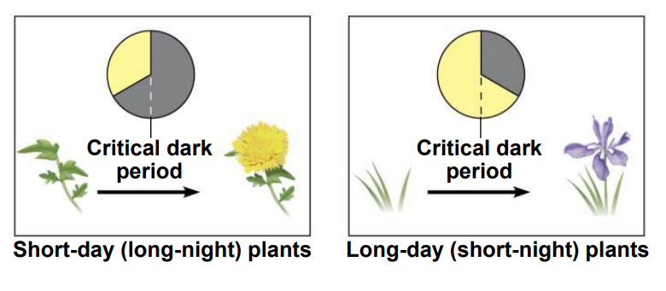

Slide 70
33.12 Phytochromes are light detectors that may help set the biological clock
How does a plant measure photoperiod?
• Phytochromes
• are proteins with a light-absorbing component and
• may help plants set their biological clock and monitor photoperiod.
• Phytochromes were discovered during studies on how different wavelengths of light affect seed germination.
• Red light with wavelength of 660nm was found to be most effective at increasing germination. Light in far-red range 730 nm inhibited germination.

Slide 71
• Phytochromes detect light in the red and far-red wavelengths and change back and forth between two forms that differ slightly in structure.
• One form of phytochrome absorbs red light (Pr ).
• One form detects far-red light (Pfr).
• When Pr absorbs red light, it is converted into Pfr.
• When Pfr absorbs far-red light, it is converted into Pr .
• Interactions between phytochrome and the biological clock enable plants to measure the passage of night and day.

Slide 72
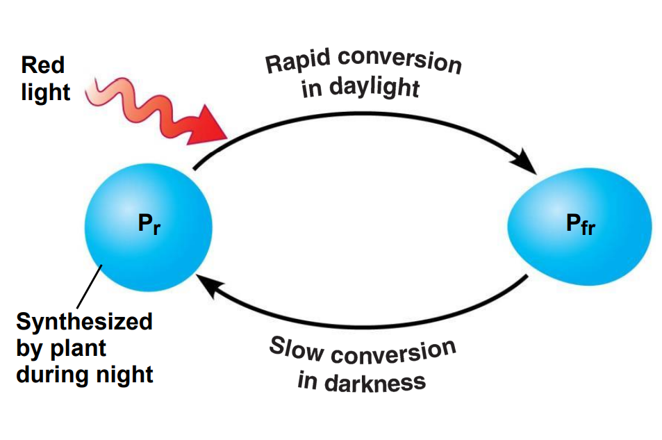

• Pr is naturally produced during dark hours, while Pfr is broken down.
• The relative amounts of Pr and Pfr present in a plant change as day length changes.
• The consequences of this phytochrome switch are shown in Figure 33.12B.

Slide 73
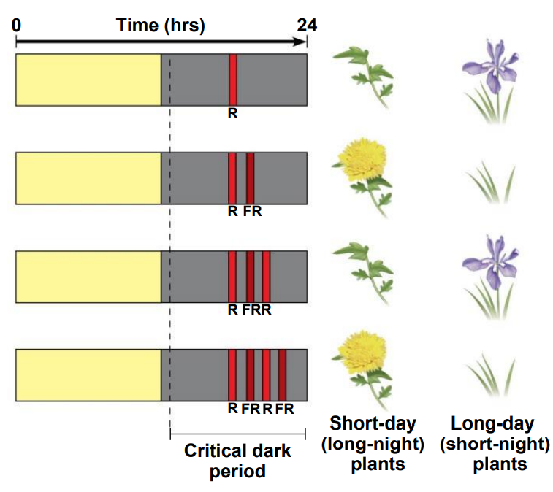

Slide 74
You should now be able to
Describe the experiments and conclusions of the phototropism research performed by the Darwins, Boysen-Jensen, and Went.
2. Describe the functions of the five major types of plant hormones.
3. Describe the uses of plant hormones in modern agriculture and the ethical issues associated with their use.
4. Define phototropism, gravitropism, and thigmotropism.

Slide 75
You should now be able to
5. Explain how biological clocks work and how they influence the lives of plants.
6. Distinguish between short-day plants and longday plants.
7. Describe the roles of phytochromes in plants.
8. Explain how plants defend themselves against herbivores.

